Slide 1
Continuous Representations for Natural Language Understanding
Scott Wen-tau Yih
DeepLearn2017, Bilbao

Slide 2
Acknowledgement
Materials
H. Poon, C. Quirk, K. Toutanova, W. Yih. “Natural Language Processing for Precision Medicine.” ACL-17.
W. Yih, H. Ma. “Question Answering with Knowledge Base, Web and Beyond.” NAACL-HLT-16 & SIGIR-16.
W. Yih, X. He, J. Gao. “Deep Learning and Continuous Representations for NLP.” NAACL-HLT-15 & IJCAI-16.
Additional slides from Jianfeng Gao, Kristina Toutanova, Bill Dolan & others
Collaborators
Kai-Wei Chang, Ming-Wei Chang, Jianfeng Gao, Xiaodong He, Mohit Iyyer, Deng Li, Victoria Lin, Hao Ma, Chris Meek, Tomas Mikolov, Hoifung Poon, Chris Quirk, Matt Richardson, Jina Suh, Huan Sun, Kristina Toutanova, Bishan Yang, Yi Yang, Geoff Zweig

Slide 3
Lecture Outline
Part 1: Background
Natural language understanding – A variety of question answering tasks
Basics of deep learning
Part 2: Knowledge Base Embedding & Information Extraction
Part 3: Semantic Parsing & Question & Answering

Slide 4

Natural Language Understanding
Question-answering machine [Simmons CACM-65]
General-purpose language processors that communicate with users in natural language (e.g., English)
Deal with statements and/or questions
http://csunplugged.org/turing-test

Slide 5
Categories of (Early) QA Systems
List-structured database systems
Organizing knowledge (e.g., kinship) in list DB
Graphic database systems
Map text and graphic data (e.g., pictures, diagrams) to the same logical representations
Text-based systems
Matching questions and text in a corpus to find answers
Logical inference systems
Textual entailment, answering science text book questions & algebra word problems

Slide 6
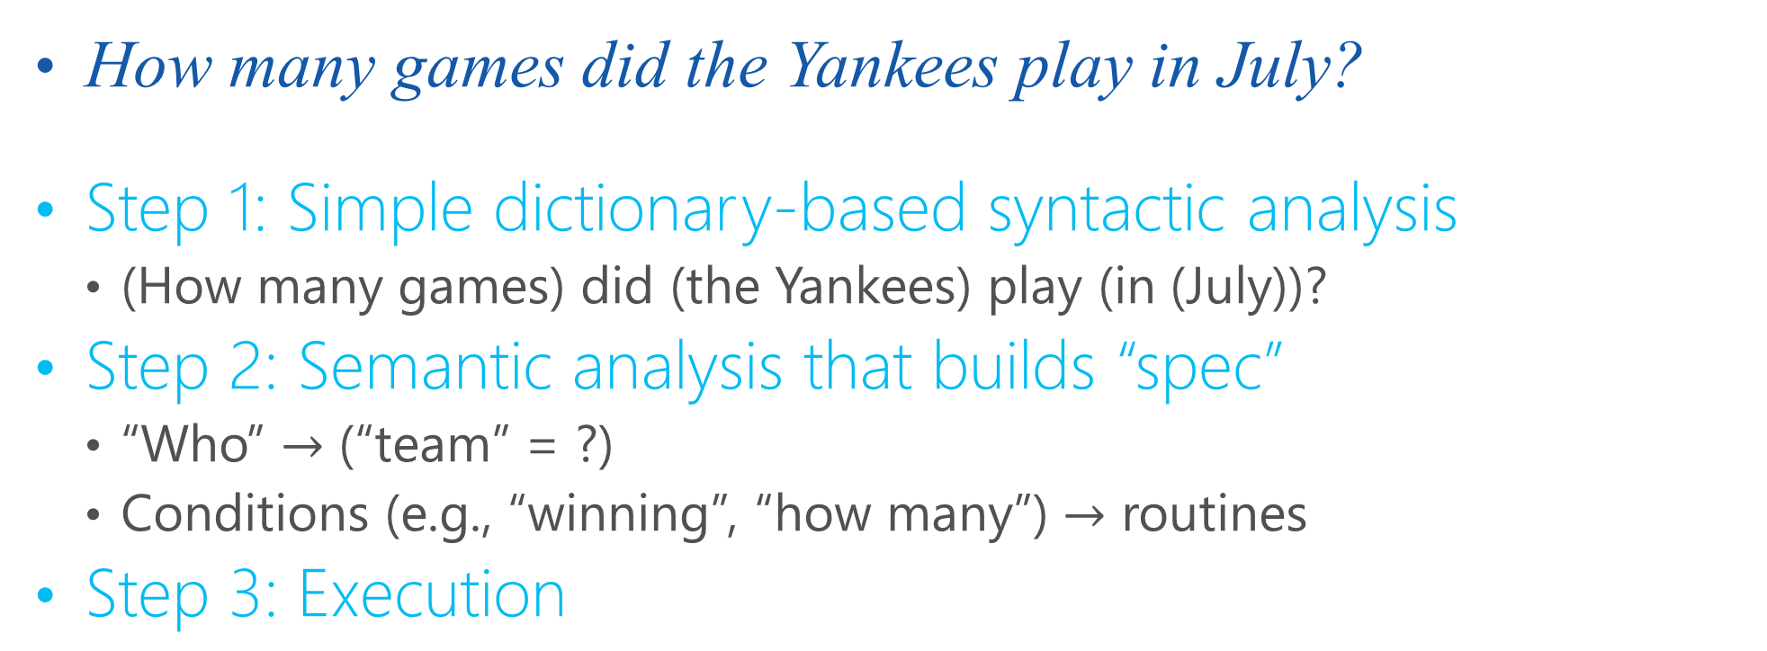
Baseball [Green, Wolf, Chomsky & Laughery, 1961]
How many games did the Yankees play in July?
Step 1: Simple dictionary-based syntactic analysis
(How many games) did (the Yankees) play (in (July))?
Step 2: Semantic analysis that builds “spec”
“Who” $→$ (“team” = ?)
Conditions (e.g., “winning”, “how many”) $→$ routines
Step 3: Execution
Month = July
Place1 = Boston
Day1 = 7
Game Serial Number = 96
Team = Red Sox, Score = 5
Team = Yankees, Score = 3
Example taken from [Simmons, 1965]

Slide 7
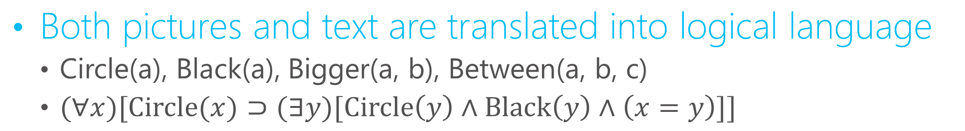
The Picture Language Machine [Krisch, 1964]
Is the statement true? All circles are black circles.
Both pictures and text are translated into logical language
Circle(a), Black(a), Bigger(a, b), Between(a, b, c)
$(∀x)[\text{Circle}(x)⊃(∃y)[\text{Circle}\left(y\right)∧\text{Black}\left(y\right)∧\left(x=y\right)]]$

Slide 8
Protosynthex [Simmons+, 1964] Answer Questions from an Encyclopedia
Matching questions & text in dependency logic [Hays 1962]
Q: What do worms eat?
A1: Worms eat grass
A2: Horses with worms eat grain
worms
worms
horses
eat
eat
with
eat
what
grass
worms
grain
Complete Agreement
Partial Agreement

Slide 9
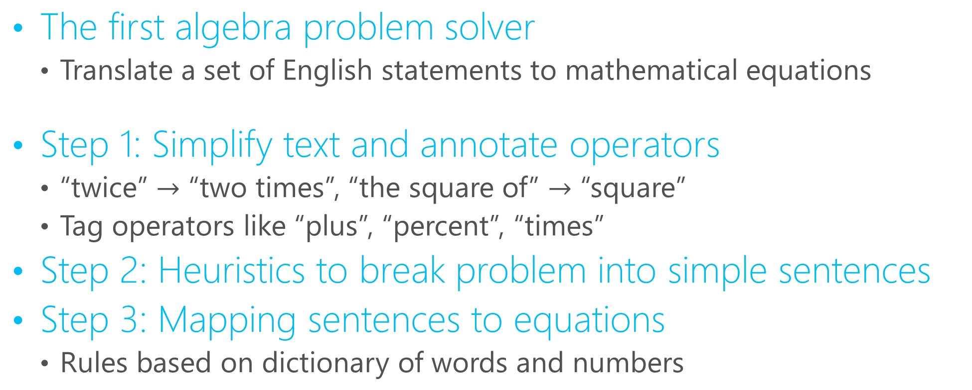
Student [Bobrow 1964]
The first algebra problem solver
Translate a set of English statements to mathematical equations
Step 1: Simplify text and annotate operators
“twice” $→$ “two times”, “the square of” $→$ “square”
Tag operators like “plus”, “percent”, “times”
Step 2: Heuristics to break problem into simple sentences
Step 3: Mapping sentences to equations
Rules based on dictionary of words and numbers

Slide 10
Lessons from Old QA Systems
Limited success
Small & limited domains and scopes
Often work only on well-controlled, specialized subset of English
Not data-driven (e.g., machine learning approaches)
Mostly rule-based, potentially brittle
Lacks rigorous evaluation
Open questions [Simmons 1965]
Meaning representation & the need of formal languages
Syntactic and semantic disambiguation
Combine partial answers from various sources

Slide 11
Categories of Modern QA Systems/Problems
Factoid questions
Informational queries about facts of entities
Competitions (Jeopardy! & Quiz Bowl)
Narrative questions
Opinion, instructions (how-to questions)
Multi-modal
Visual QA
Travel Assistant
AI ability tests
Reading comprehension
Elementary School Science and Math Tests

Slide 12
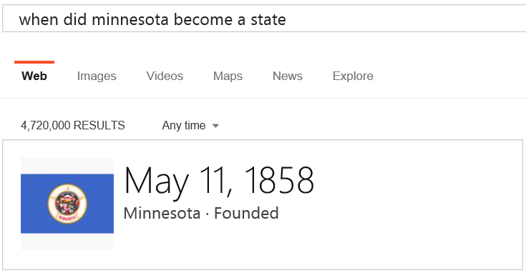
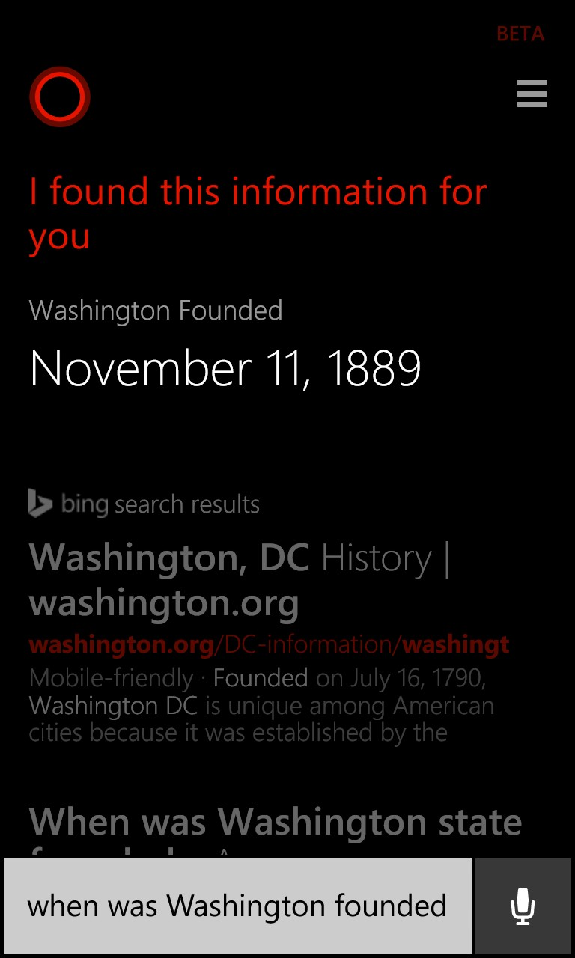
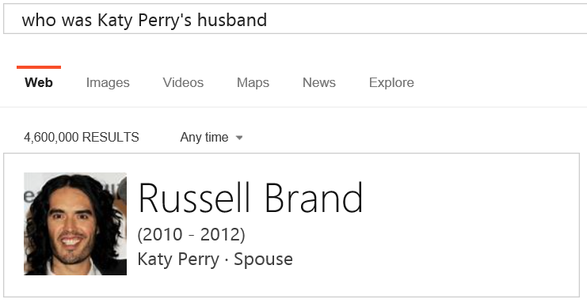
Factoid Questions

Slide 13
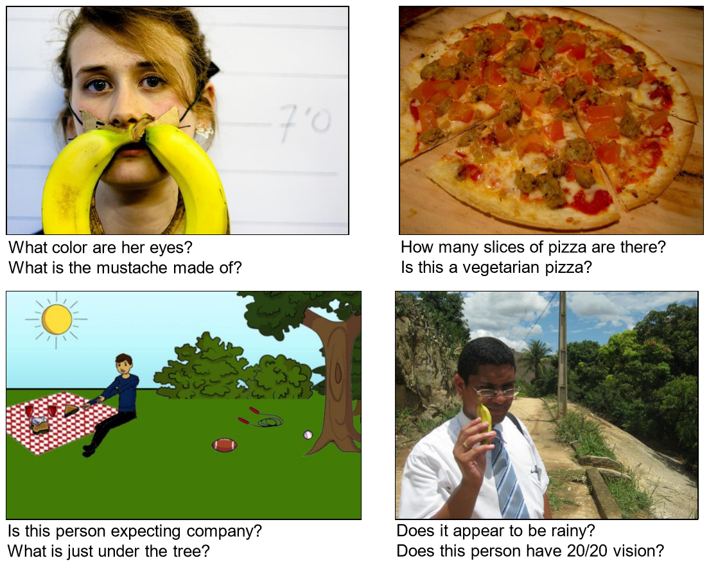
Visual Question Answering [Agrawal et al.]

Slide 14
Machine Comprehension Test [Richardson+ 2013]
James the Turtle was always getting in trouble. Sometimes he'd reach into the freezer and empty out all the food. Other times he'd sled on the deck and get a splinter. His aunt Jane tried as hard as she could to keep him out of trouble, but he was sneaky and got into lots of trouble behind her back.
One day, James thought he would go into town and see what kind of trouble he could get into. He went to the grocery store and pulled all the pudding off the shelves and ate two jars. Then he walked to the fast food restaurant and ordered 15 bags of fries. He didn't pay, and instead headed home.
His aunt was waiting for him in his room. She told James that she loved him, but he would have to start acting like a well-behaved turtle.
After about a month, and after getting into lots of trouble, James finally made up his mind to be a better turtle.
1) What is the name of the trouble making turtle?
A) Fries
B) Pudding
C) James
D) Jane
2) What did James pull off of the shelves in the grocery store?
A) pudding
B) fries
C) food
D) splinters

Slide 15
Challenge of NLP: the Diversity of Natural Language
Many-to-many mapping between symbolic language and semantic meaning
Paraphrase
Example: How long is the X river?
The Mississippi River is 3,734 km (2,320 mi) long.
...is a short river, some 4.5 miles (7.2 km) in length
The total length of the river is 2,145 kilometers.
… at the estimated length of 5,464 km (3,395 mi)…
… has a meander length of 444 miles (715 km)…
… Bali’s longest river, measuring approximately 75 kilometers from source to mouth.
The … mainstem is 2.75 miles (4.43 km) long although total distance from headwater source tributaries to the sea is 14 miles (23 km).
Ambiguity
Example: I made her duck.
I cooked waterfowl for her.
I cooked waterfowl belonging to her.
I created the plaster duck she owns.
I caused her to quickly lower her head or body.
I waved my magic wand and turned her into undifferentiated waterfowl.
[Jurafsky & Martin 10; Dolan 17]

Slide 16
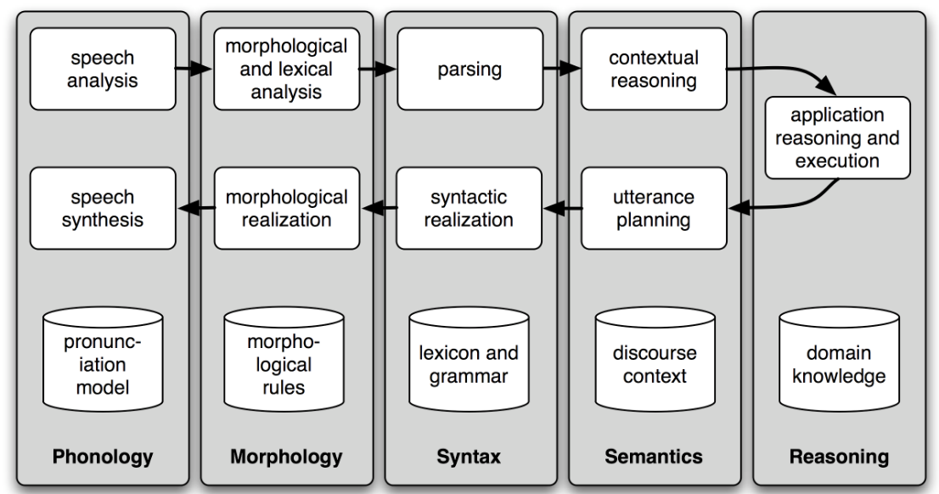
Traditional NLP Components and Pipeline
Natural language understand (NLU): parsing (speech) input to semantic meaning and update the system state
Application reasoning and execution: take the next action based on state
Natural language generation (NLG): generating (speech) response from action
[Menezes & Dolan 17]

Slide 17
Transition of NLP to Neural Methods
Paradigm shift: from symbolic to neural computation
End-to-end learning simplifies systems, reduces effort for feature engineering and localization
Empirical success
New state-of-the-art results at both component level and end application
Infrastructure
Long-term success relies on BIG data
Large-scale (GPU) compute resources are critical
[Arul Menezes & Bill Dolan. 2017. The transition of natural language processing to neural methods. Unpublished report.]

Slide 18
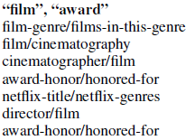
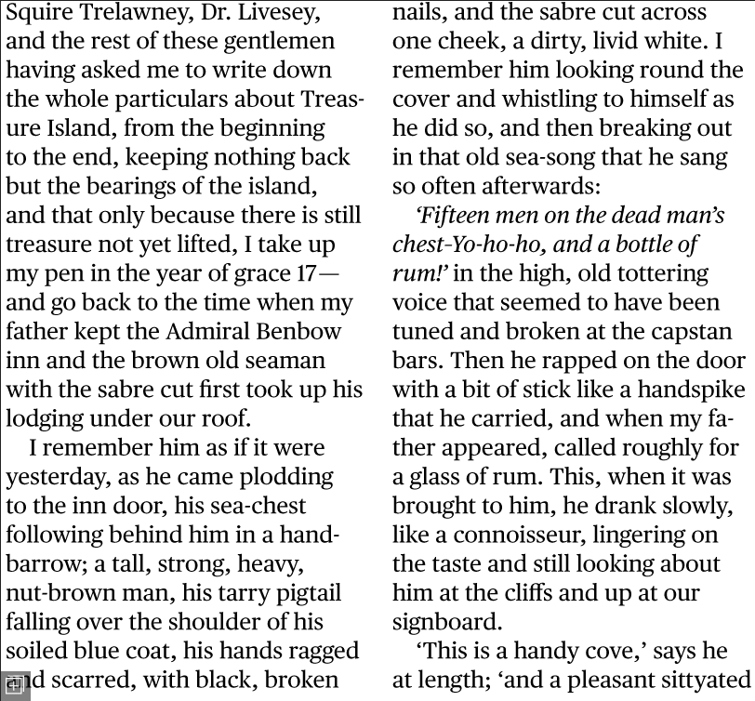
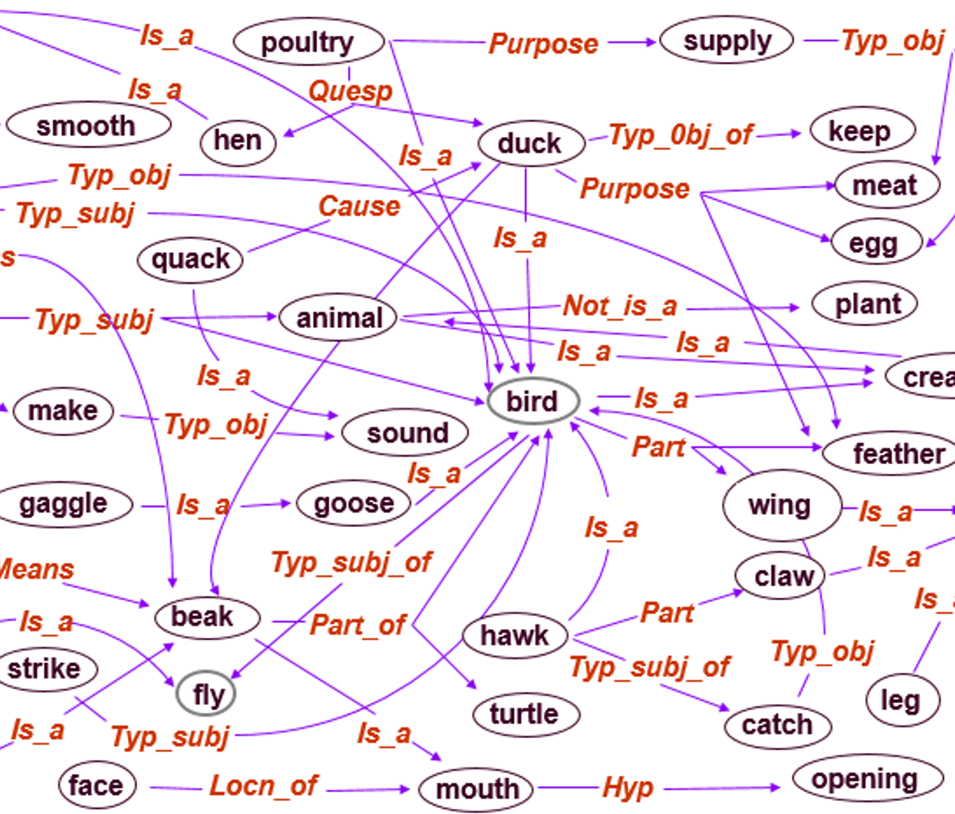
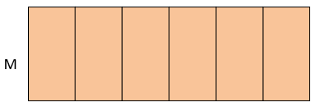
Paradigm Shift in NLP
Traditional symbolic approaches
Discrete, symbolic space
Human comprehensible
easy to debug
Computationally inefficient
Sensitive to ambiguity/paraphrase
Cascaded models prone to error propagation and require careful feature engineering
Deep Neural Model (DNN) approaches
Continuous, neural space
Human incomprehensible
hard to debug
Computationally efficient
Robust to ambiguity/paraphrase
E2E learning leads to better performance and simplified systems
[Arul Menezes & Bill Dolan. 2017. The transition of natural language processing to neural methods. Unpublished report.]

Slide 19
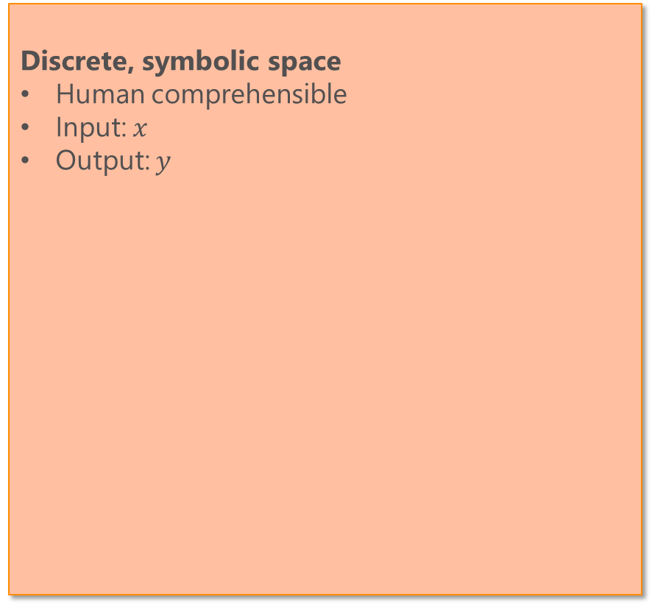
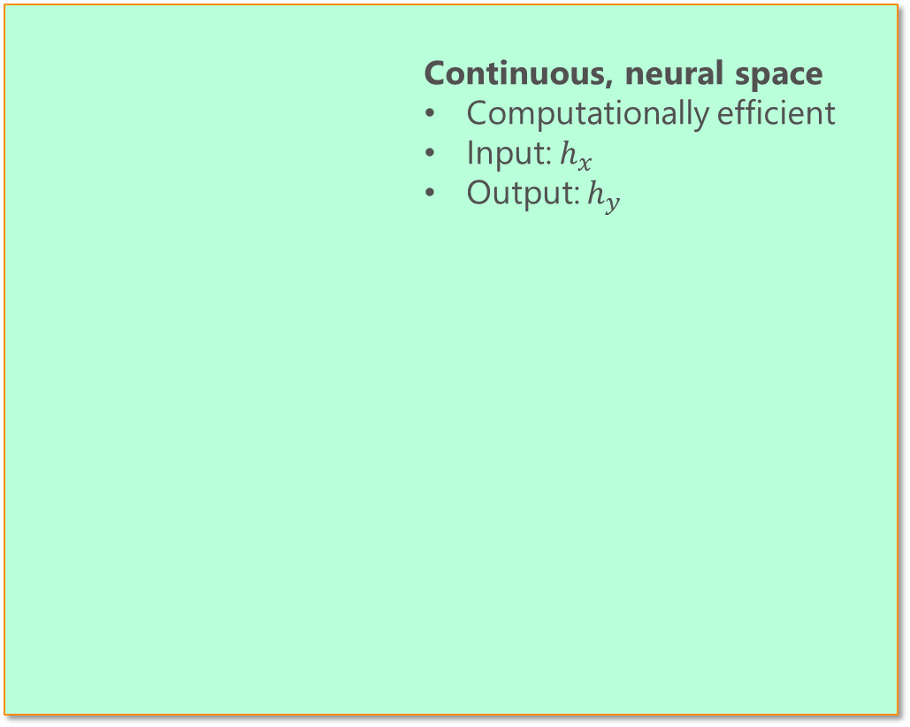
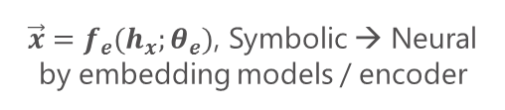




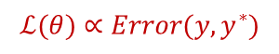
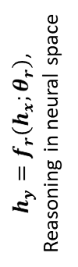
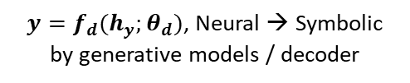
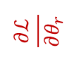
End-to-End Neural Approaches
Discrete, symbolic space
Human comprehensible
Input: $x$
Output: $y$
Continuous, neural space
Computationally efficient
Input: $h_{x}$
Output: $h_{y}$
$\vec{x}=f_{e}(h_{x};θ_{e})$, Symbolic → Neural
by embedding models / encoder
$$\frac{∂ℒ}{∂θ_{e}}$$
$$\frac{∂ℒ}{∂θ_{r}}$$
$h_{y}=f_{r}\left(h_{x};θ_{r}\right)$, Reasoning in neural space
$$\frac{∂ℒ}{∂θ_{d}}$$
$$ℒ(θ)∝Error(y,y^{∗})$$
$y=f_{d}(h_{y};θ_{d})$, Neural → Symbolic
by generative models / decoder
[Arul Menezes & Bill Dolan. 2017. The transition of natural language processing to neural methods. Unpublished report.]

Slide 20
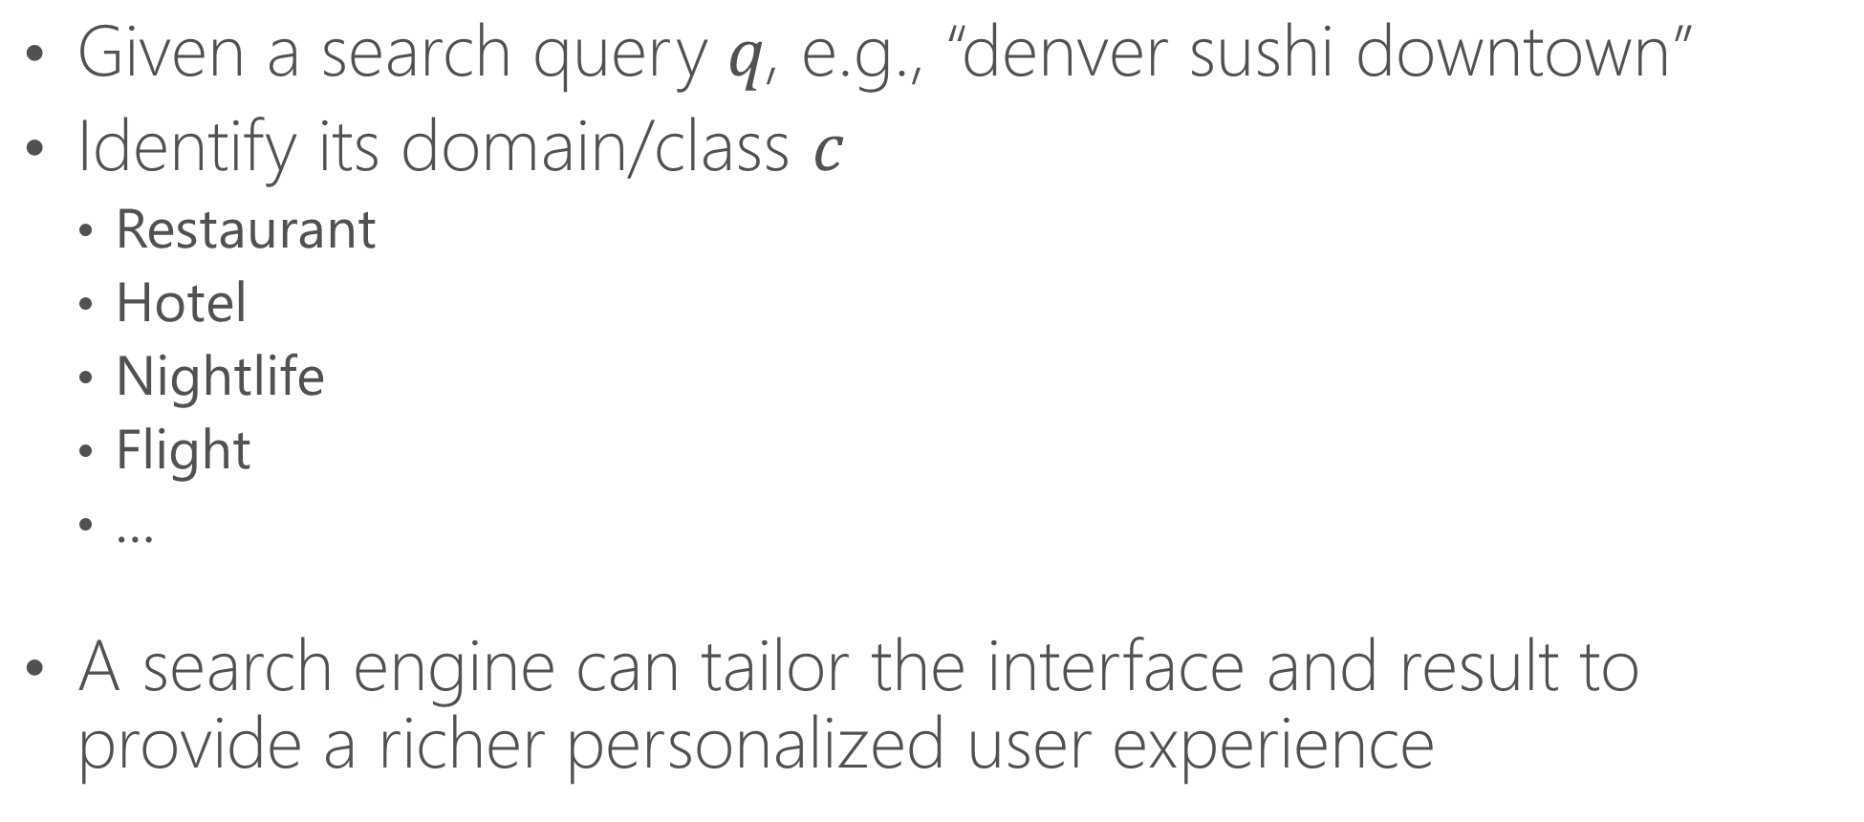
A Simple Example: Text (Query) Classification
Given a search query 𝑞, e.g., “denver sushi downtown”
Identify its domain/class $c$
Restaurant
Hotel
Nightlife
Flight
…
A search engine can tailor the interface and result to provide a richer personalized user experience

Slide 21
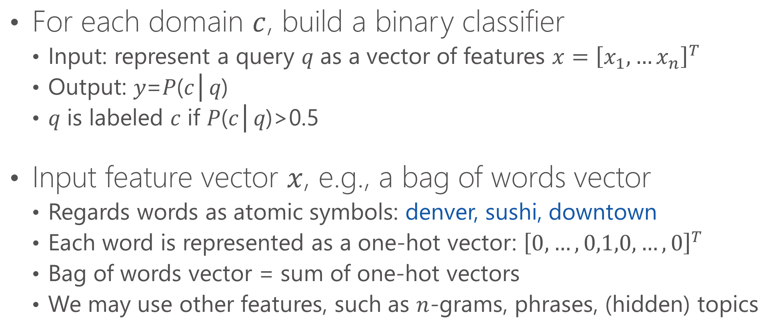
A Single-neuron Model
For each domain $c$, build a binary classifier
Input: represent a query 𝑞 as a vector of features $x={\left[x_{1},…x_{n}\right]}^{T}$
Output: 𝑦=𝑃(𝑐│𝑞)
𝑞 is labeled 𝑐 if 𝑃(𝑐│𝑞)>0.5
Input feature vector $x$, e.g., a bag of words vector
Regards words as atomic symbols: denver, sushi, downtown
Each word is represented as a one-hot vector: ${\left[0,…,0,1,0,…,0\right]}^{T}$
Bag of words vector = sum of one-hot vectors
We may use other features, such as $n$-grams, phrases, (hidden) topics

Slide 22
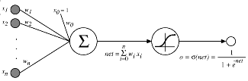
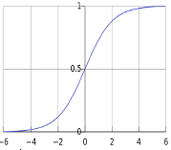

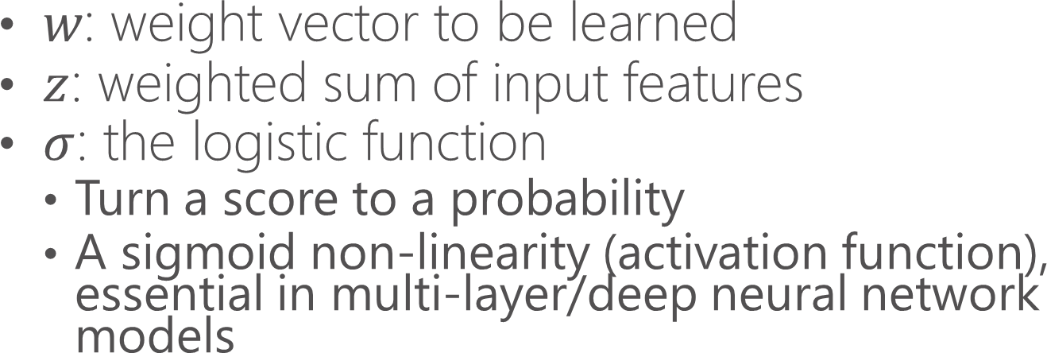
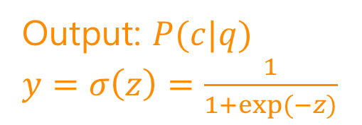
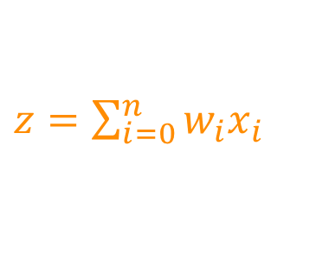
A Single-neuron Model
Output: $P(c|q)$
$y=σ\left(z\right)=\frac{1}{1+exp⁡(−z)}$
Input features $x$
$z=\sum_{i=0}^{n}{w_{i}x_{i}}$
$w\text{: }\text{weight} \text{vector} \text{to} \text{be} \text{learned}$
$z$: weighted sum of input features
$σ$: the logistic function
Turn a score to a probability
A sigmoid non-linearity (activation function), essential in multi-layer/deep neural network models

Slide 23
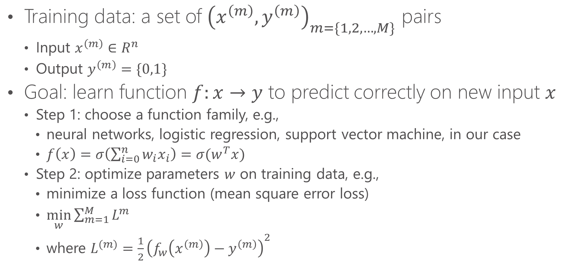
Model Training: Assign $w$
Training data: a set of ${\left(x^{\left(m\right)},y^{\left(m\right)}\right)}_{m=\{1,2,…,M\}}$ pairs
Input $x^{\left(m\right)}∈R^{n}$
Output $y^{\left(m\right)}=\{0,1\}$
Goal: learn function $f:x→y$ to predict correctly on new input $x$
Step 1: choose a function family, e.g.,
neural networks, logistic regression, support vector machine, in our case
$f\left(x\right)=σ\left(\sum_{i=0}^{n}{w_{i}x_{i}}\right)=σ(w^{T}x)$
Step 2: optimize parameters $w$ on training data, e.g.,
minimize a loss function (mean square error loss)
$\min_{w}{\sum_{m=1}^{M}{L^{m}}}$
where ${L^{(m)}=\frac{1}{2}\left(f_{w}\left(x^{\left(m\right)}\right)−y^{\left(m\right)}\right)}^{2}$

Slide 24
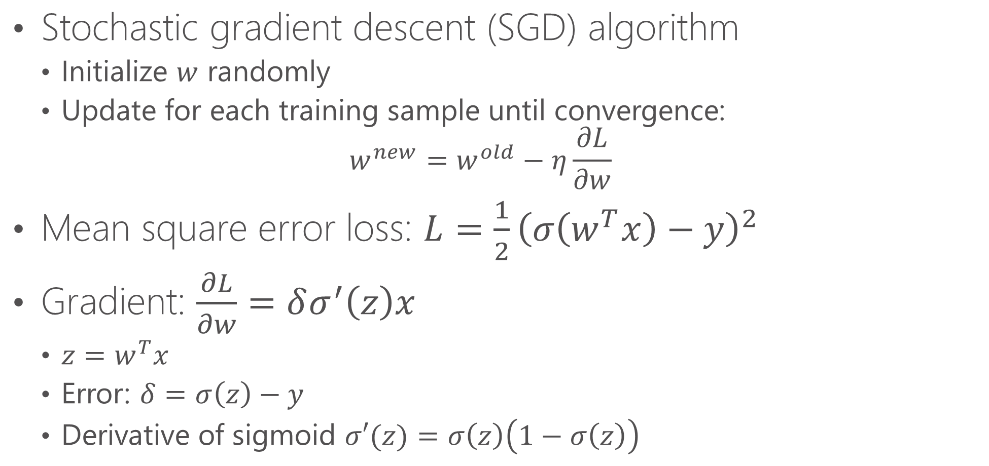
Model Training: Assign $w$
Stochastic gradient descent (SGD) algorithm
Initialize $w$ randomly
Update for each training sample until convergence: $w^{new}=w^{old}−η\frac{∂L}{∂w}$
Mean square error loss: ${L=\frac{1}{2}\left(σ\left(w^{T}x\right)−y\right)}^{2}$
Gradient: $\frac{∂L}{∂w}=δσ^{′}\left(z\right)x$
$z=w^{T}x$
Error: $δ=σ\left(z\right)−y$
Derivative of sigmoid $σ′(z)=σ\left(z\right)\left(1−σ\left(z\right)\right)$

Slide 25
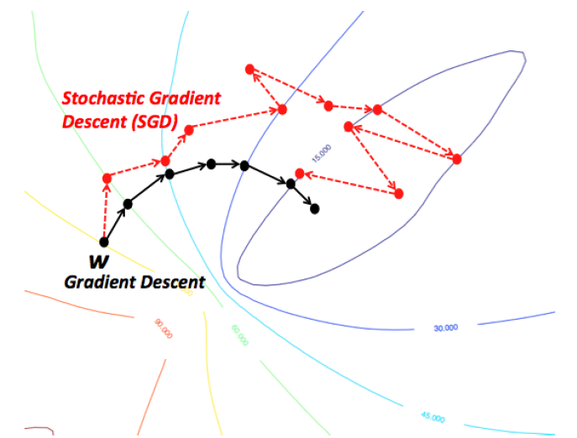
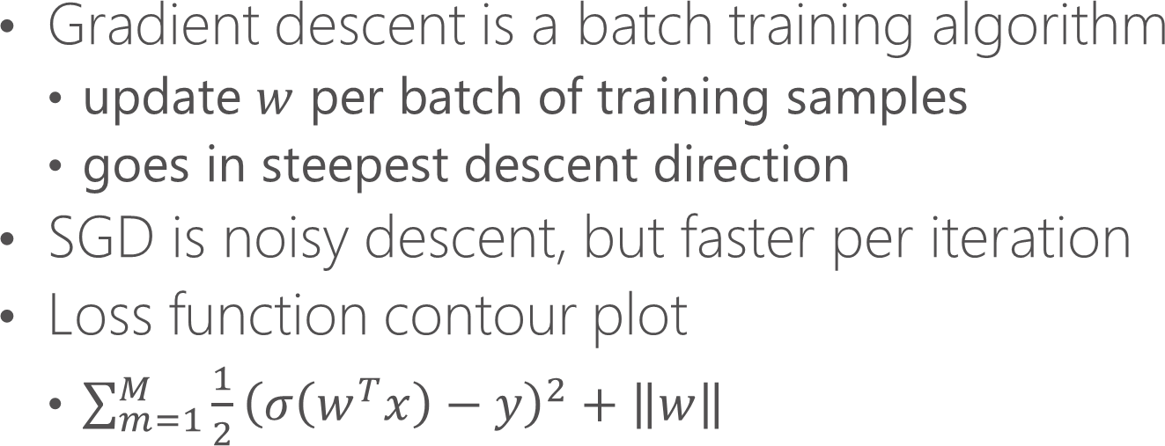
SGD vs. Gradient Descent
Gradient descent is a batch training algorithm
update $w$ per batch of training samples
goes in steepest descent direction
SGD is noisy descent, but faster per iteration
Loss function contour plot
$\sum_{m=1}^{M}{\frac{1}{2}{\left(σ\left(w^{T}x\right)−y\right)}^{2}}+\left\|w\right\|$
[Duh, K. 2014. Deep learning for natural language processing and machine translation. Tutorial.]

Slide 26
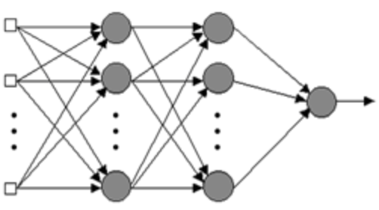


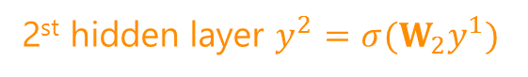


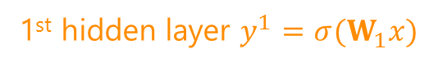
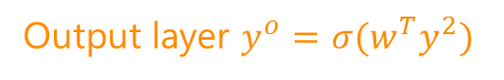
Multi-layer (Deep) Neural Networks
Output layer $y^{o}=σ(w^{T}y^{2})$
Vector $w$
This is exactly the single neuron model
with hidden features.
2st hidden layer $y^{2}=σ(W_{2}y^{1})$
Projection matrix $W_{2}$
Feature generation: project raw input features (bag of words) to hidden features (topics).
1st hidden layer $y^{1}=σ(W_{1}x)$
Projection matrix $W_{1}$
Input features $x$

Slide 27
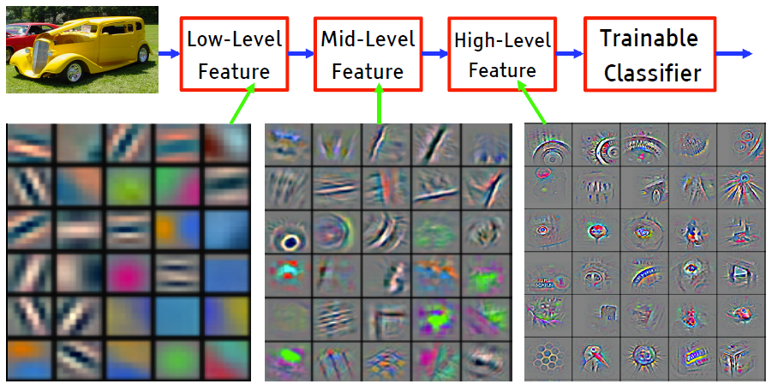
Why Multiple Layers? [DL tutorial at NIPS’2015]
Hierarchy of representations with increasing level of abstraction
Each layer is a trainable feature transform
Image recognition: pixel → edge → texton → motif → part → object
?? Text: character → word → word group → clause → sentence → story

Slide 28
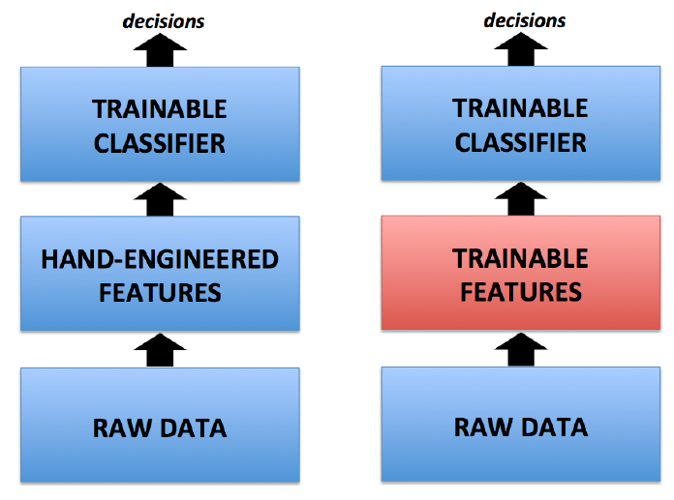
Standard Machine Learning Process
Deep Learning
Adapted from [Duh 14]

Slide 29
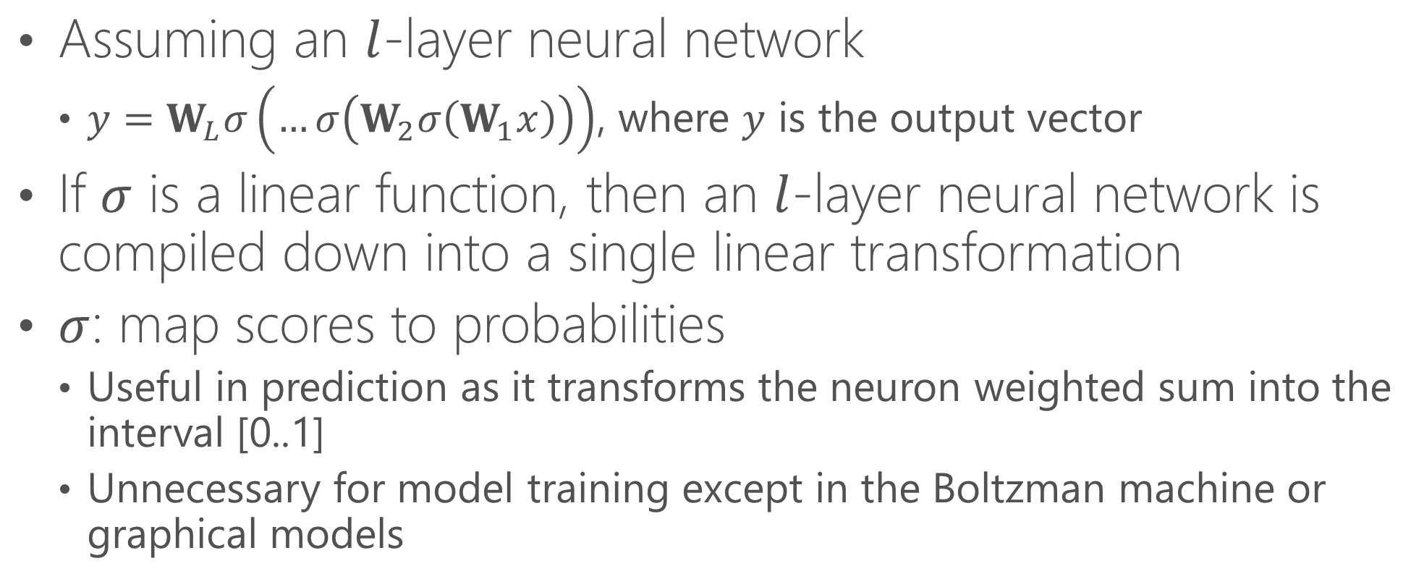
Revisit the Activation Function: $σ$
Assuming an $l$-layer neural network
$y=W_{L}σ\left(…σ\left(W_{2}σ\left(W_{1}x\right)\right)\right)$, where $y$ is the output vector
If $σ$ is a linear function, then an $l$-layer neural network is compiled down into a single linear transformation
$σ$: map scores to probabilities
Useful in prediction as it transforms the neuron weighted sum into the interval [0..1]
Unnecessary for model training except in the Boltzman machine or graphical models

Slide 30
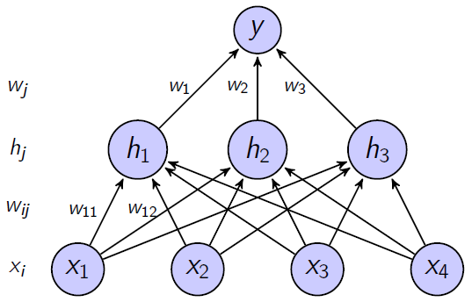
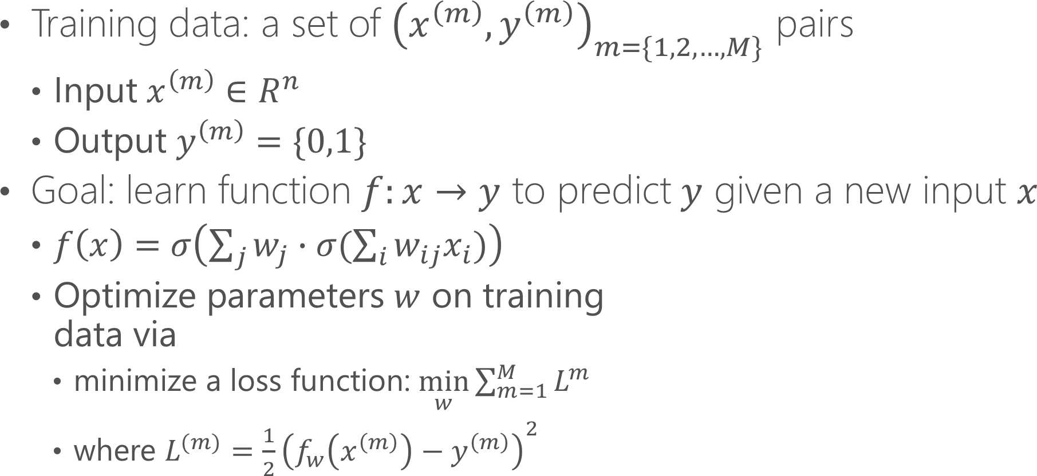
Training a Two-layer Neural Networks
Training data: a set of ${\left(x^{\left(m\right)},y^{\left(m\right)}\right)}_{m=\{1,2,…,M\}}$ pairs
Input $x^{\left(m\right)}∈R^{n}$
Output $y^{\left(m\right)}=\{0,1\}$
Goal: learn function $f:x→y$ to predict $y$ given a new input $x$
$f\left(x\right)=σ\left(\sum_{j}{w_{j}}∙σ(\sum_{i}{w_{ij}x_{i}})\right)$
Optimize parameters $w$ on training data via
minimize a loss function: $\min_{w}{\sum_{m=1}^{M}{L^{m}}}$
where ${L^{(m)}=\frac{1}{2}\left(f_{w}\left(x^{\left(m\right)}\right)−y^{\left(m\right)}\right)}^{2}$

Slide 31
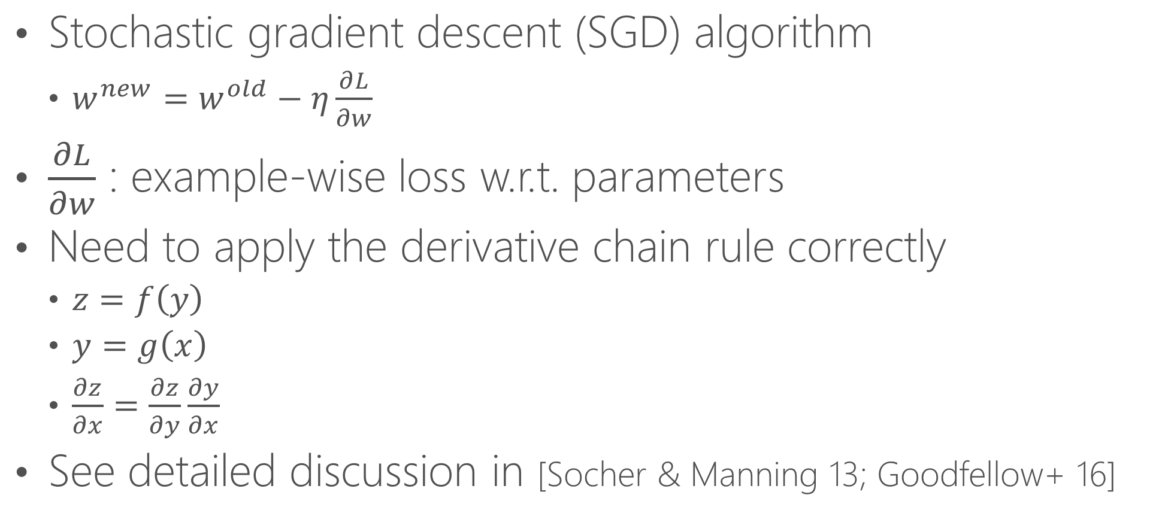
Training Neural Nets: Back-propagation
Stochastic gradient descent (SGD) algorithm
$w^{new}=w^{old}−η\frac{∂L}{∂w}$
$\frac{∂L}{∂w}$ : example-wise loss w.r.t. parameters
Need to apply the derivative chain rule correctly
$z=f\left(y\right)$
$y=g\left(x\right)$
$\frac{∂z}{∂x}=\frac{∂z}{∂y}\frac{∂y}{∂x}$
See detailed discussion in [Socher & Manning 13; Goodfellow+ 16]

Slide 32
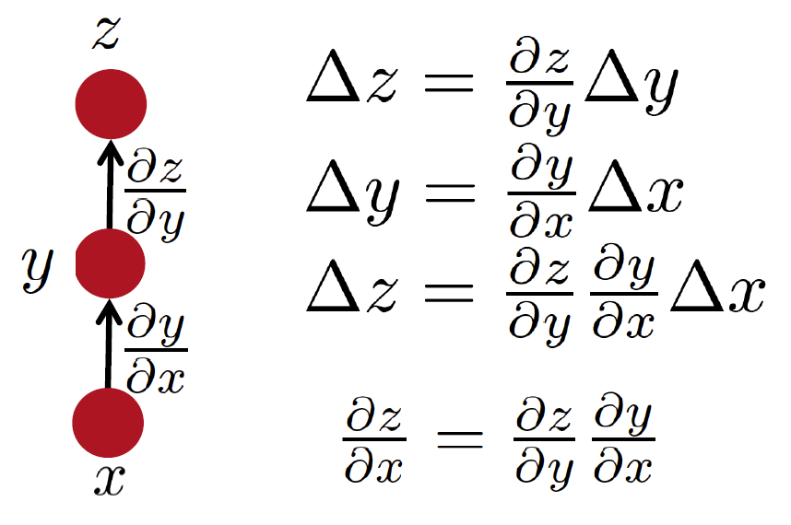
Simple Chain Rule
[Socher & Manning NAACL 2013 Tutorial]

Slide 33
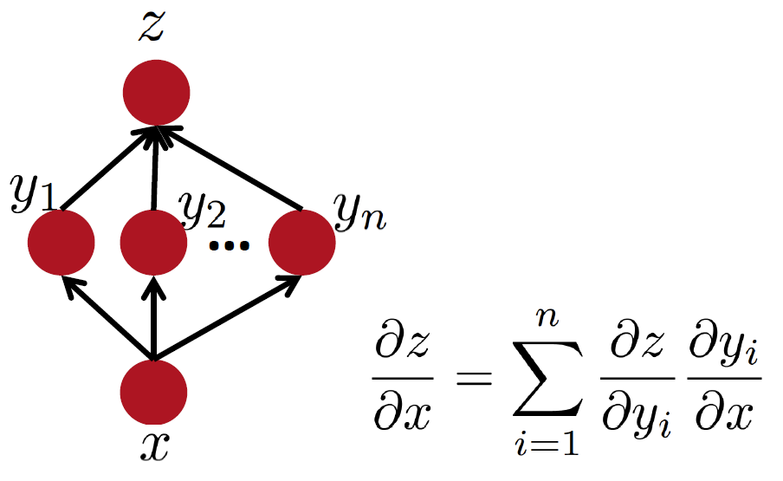
Multiple Paths Chain Rule
[Socher & Manning 13]

Slide 34
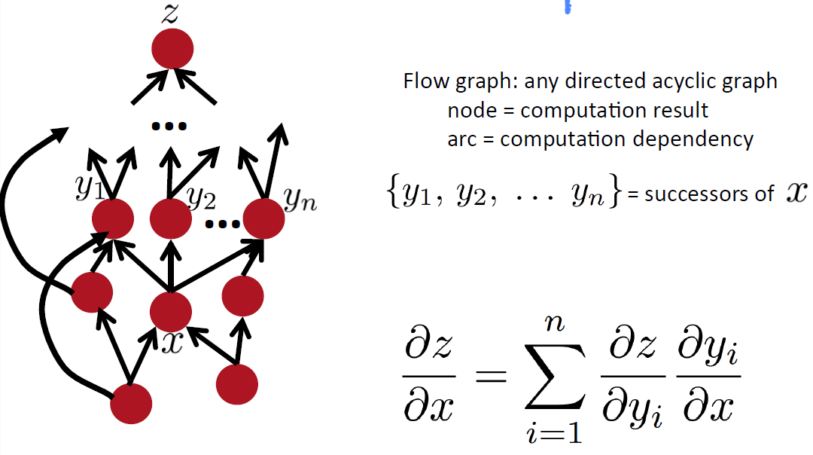
Chain Rule in Flow Graph (DAG)
[Socher & Manning 13]

Slide 35
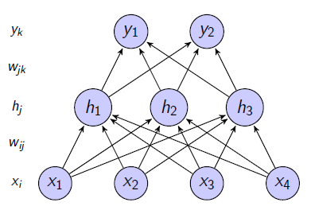
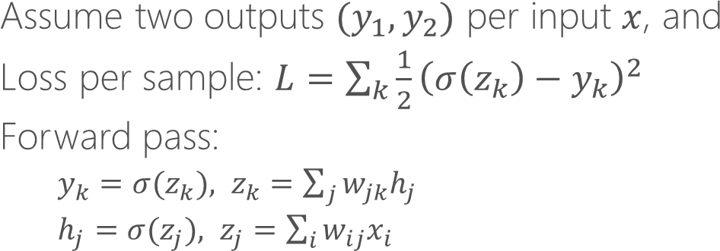
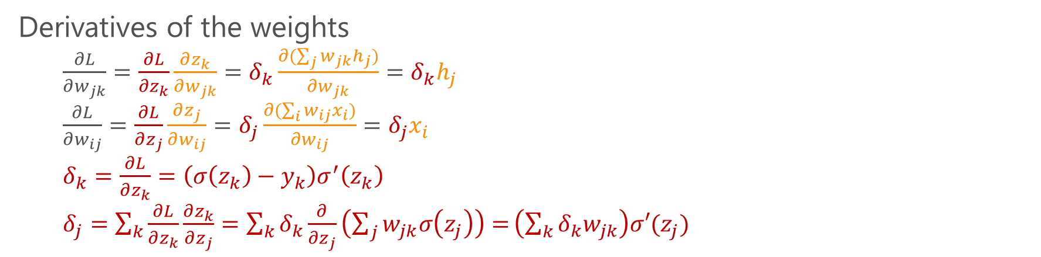
Training Neural Nets: Back-propagation
Assume two outputs $(y_{1},y_{2})$ per input $x$, and
Loss per sample: $L=\sum_{k}{\frac{1}{2}{\left(σ\left(z_{k}\right)−y_{k}\right)}^{2}}$
Forward pass:
$y_{k}=σ(z_{k}), z_{k}=\sum_{j}{w_{jk}h_{j}}$
$h_{j}=σ(z_{j}), z_{j}=\sum_{i}{w_{ij}x_{i}}$
Derivatives of the weights
$\frac{∂L}{∂w_{jk}}=\frac{∂L}{∂z_{k}}\frac{∂z_{k}}{∂w_{jk}}=δ_{k}\frac{∂(\sum_{j}{w_{jk}h_{j}})}{∂w_{jk}}=δ_{k}h_{j}$
$\frac{∂L}{∂w_{ij}}=\frac{∂L}{∂z_{j}}\frac{∂z_{j}}{∂w_{ij}}=δ_{j}\frac{∂(\sum_{i}{w_{ij}x_{i}})}{∂w_{ij}}=δ_{j}x_{i}$
$δ_{k}=\frac{∂L}{∂z_{k}}=\left(σ\left(z_{k}\right)−y_{k}\right)σ^{′}\left(z_{k}\right)$
$δ_{j}=\sum_{k}{\frac{∂L}{∂z_{k}}\frac{∂z_{k}}{∂z_{j}}}=\sum_{k}{δ_{k}\frac{∂}{∂z_{j}}\left(\sum_{j}{w_{jk}σ\left(z_{j}\right)}\right)=}\left(\sum_{k}{δ_{k}w_{jk}}\right)σ′(z_{j})$
Adapted from [Duh 14]

Slide 36
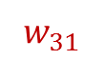
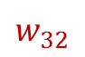
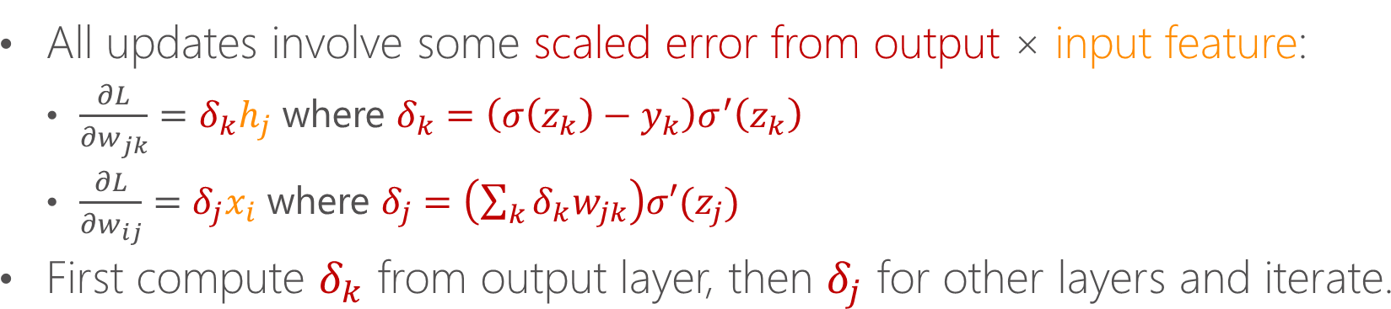
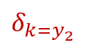

Training Neural Nets: Back-propagation
All updates involve some scaled error from output × input feature:
$\frac{∂L}{∂w_{jk}}=δ_{k}h_{j}$ where $δ_{k}=\left(σ\left(z_{k}\right)−y_{k}\right)σ^{′}\left(z_{k}\right)$
$\frac{∂L}{∂w_{ij}}=δ_{j}x_{i}$ where $δ_{j}=\left(\sum_{k}{δ_{k}w_{jk}}\right)σ′(z_{j})$
First compute $δ_{k}$ from output layer, then $δ_{j}$ for other layers and iterate.
$$δ_{k=y_{1}}$$
$$δ_{k=y_{2}}$$
$δ_{j=h_{3}}=\left(δ_{k=y_{1}}w_{31}+δ_{k=y_{2}}w_{32}\right)σ′(z_{j=h_{3}})$
$$w_{31}$$
$$w_{32}$$
Adapted from [Duh 14]

Slide 37
Neural Models for Different Input Structures
Multi-Layer Perceptron (MLP)
Text as a bag of words
Convolutional Neural Network (CNN)
Text as a bag of chunks
Recurrent Neural Network (RNN)
Text as a sequence of words

Slide 38
Neural Models for Different Input Structures
Classification task – label 𝑥 by 𝑦
MLP/CNN/RNN as feature generator
Ranking task – Semantic similarity between 𝑥 and 𝑦
Siamese neural network [Bromley et al. 1993]
Deep Semantic Similarity Model (DSSM)
(Text) Generation task – generate 𝑦 from 𝑥
Seq2Seq (RNN/LSTM)
Memory Network

Slide 39
Part 2: Knowledge Base Embedding & Information Extraction

Slide 40

Knowledge Base
Captures world knowledge by storing properties of millions of entities, as well as relations among them
Freebase
DBpedia
YAGO
NELL
OpenIE/ReVerb

Slide 41




Current KB Applications in NLP & IR
Question Answering
“What are the names of Obama’s daughters?”
$λx.parent\left(Obama,x\right)∧gender(x,Female)$
Information Extraction
“Hathaway was born in Brooklyn, New York.”
$bornIn(Hathaway, Brooklyn)$
$contains(New York, Brooklyn)$
Web Search
Identify entities and relationships in queries
KB
Malia Obama
Natasha Obama

Slide 42


Information Extraction
Understand text by identifying entities and their relations
Produce or store the information in a structured form
Michelle Obama, née Robinson, the wife of Barack Obama, was born on January 17, 1964, in Chicago, Illinois.
Maiden_name(Michelle_Obama, Robinson)
Wife_of(Michelle_Obama, Barack_Obama)
Birth_date(Michelle_Obama, Jan-17-1964)
Located_in(Chicago, Illinois)
Birth_city(Michelle_Obama, Chicago)
Birth_state(Michelle_Obama, Illinois)

Slide 43
Knowledge Base (KB) Completion
Reason for new facts based on existing knowledge
Maiden_name(Michelle_Obama, Robinson)
Wife_of(Michelle_Obama, Barack_Obama)
Birth_date(Michelle_Obama, Jan-17-1964)
Located_in(Chicago, Illinois)
Birth_city(Michelle_Obama, Chicago)
Birth_state(Michelle_Obama, Illinois)
Birth_city($x,y$) $∧$ Located_in($y,z$) $∧$ State($z$) $→$ Birth_state($x, z$)

Slide 44

Reasoning with Knowledge Base
Knowledge base is never complete!
Predict new facts: $Nationality(Natasha Obama, ?)$
Mine rules: $BornInCity\left(a,b\right)∧CityInCountry\left(b,c\right)⇒Nationality(a,c)$
Modeling multi-relational data
Statistical relational learning [Getoor & Taskar, 2007]
Path ranking methods (e.g., random walk) [e.g., Lao+ 2011]
Knowledge base embedding

Slide 45


Statistical relational learning [Getoor & Taskar, 2007]
Modeling dependencies among the truth values of multiple possible relations
Powerful models can be prohibitively expensive
For example, marginal inference is exponential in the tree width for Markov Random Fields
adult
adult
child
Example from Nickel et al “Review of Relational Machine Learning for Knowledge Graphs”

Slide 46
Path Ranking Methods
For example, random walk approaches [Lao+ 2011]
Assumes truth values of unknown facts are independent given observed facts
Difficulty capturing dependencies through long relation paths
Sparsity when number of relation types is large

Slide 47








Path Ranking Algorithm [Lao et al 11]
To score (s,r,t), collect the path types of paths connecting s and t
Each path type is a feature with value the path-constrained random walk probability
The scoring function is linear in the given feature values
Can be computationally expensive if many relation types and long paths allowed
city_of
$π_{1}$:
born_in
city_of
$$p=1$$
Honolulu
$π_{2}$:
nationality
$$p=1$$
spouse
born_in
United States
Barack Obama
spouse
Michelle Obama
nationality

Slide 48
Knowledge Base Embedding
Assumes truth values of facts are independent given latent features (embeddings) of entities and relations
Can be very efficient in prediction time
For example, matrix multiplication for prediction
Better prediction accuracy in many tasks
Hybrid approaches of path ranking and embedding methods

Slide 49

Knowledge Base Embedding – Basic Formulation
Each entity in a KB is represented by an $R^{d}$ vector
Predict whether $\left(subj, rel, obj\right)$ is true by $f_{rel}\left(s, o\right)$
Recent work on KB embedding
Tensor decomposition
RESCAL [Nickel+, ICML-11], TRESCAL [Chang+, EMNLP-14]
Neural networks
SME [Bordes+, AISTATS-12], NTN [Socher+, NIPS-13], TransE [Bordes+, NIPS-13], DISTMULT [Yang+, ICLR-15], TransH [Wang+ 2014], STransE [Nguyen+ 2016], …

Slide 50


Tensor Decomposition: Knowledge Base Representation (1/2)
Collection of subj-pred-obj triples – $(e_{1}, r, e_{2})$
Subject | Predicate | Object
Obama | BornIn | Hawaii
Bill Gates | Nationality | USA
Bill Clinton | SpouseOf | Hillary Clinton
Satya Nadella | WorkAt | Microsoft
… | … | …
$n$: # entities, $m$: # relations

Slide 51



Tensor Decomposition: Knowledge Base Representation (2/2)
$$𝒳_{k}$$
Hawaii
$k$-th slice
Obama
1
A zero entry means either:
Incorrect (false)
Unknown
$R_{k}$ : BornIn

Slide 52






Tensor Decomposition Objective
$$\frac{1}{2}\left(\sum_{k}{{\left\|𝒳_{k}−Aℛ_{k}A^{T}\right\|}_{F}^{2}}\right)+\frac{1}{2}\left({\left\|A\right\|}_{F}^{2}+\sum_{k}{{\left\|ℛ_{k}\right\|}_{F}^{2}}\right)$$
Objective:
Reconstruction Error
Regularization
$$𝒳_{k}$$
$$A$$
$$ℛ_{k}$$
$$A^{T}$$
~
×
×
~
$k$-th relation
RESCAL [Nickel+, ICML-11]

Slide 53




Measure the Degree of a Relationship
$f_{\text{BornIn}}(\text{Obama},\text{Hawaii})$
$= A_{\text{Obama}\text{,} :} ℛ_{\text{BornIn}} A_{\text{Hawaii}\text{,} :}^{T}$
$$A$$
Hawaii
$$ℛ_{\text{BornIn}}$$
$$A^{T}$$
×
×
Obama

Slide 54
Typed Tensor Decomposition – TRESCAL [Chang+ EMNLP-14]
Relational domain knowledge
Type information and constraints
Only legitimate entities are included in the loss
Benefits of leveraging type information
Faster model training time
Highly scalable to large KB
Higher prediction accuracy

Slide 55





Typed Tensor Decomposition Objective
$$\frac{1}{2}\sum_{k}{{\left\|𝒳_{k}−Aℛ_{k}A^{T}\right\|}_{F}^{2}}$$
Reconstruction error:
locations
$$𝒳_{k}$$
$$A$$
$$ℛ_{k}$$
$$A^{T}$$
~
×
×
~
people
Relation: born-in

Slide 56





Typed Tensor Decomposition Objective
$$\frac{1}{2}\sum_{k}{{\left\|𝒳_{k}^{′}−A_{k_{l}}ℛ_{k}A_{k_{r}}^{T}\right\|}_{F}^{2}}$$
Reconstruction error:
$$𝒳_{k}^{′}$$
$$A_{k_{l}}$$
$$ℛ_{k}$$
$$A_{k_{r}}^{T}$$
~
×
×
~

Slide 57





Training Procedure – Alternating Least-Squares (ALS) Method
Fix $ℛ_{k}$, update $A$
$$A←\left[\sum_{k}{𝒳_{k}Aℛ_{k}^{T}+𝒳_{k}^{T}Aℛ_{k}}\right]{\left[\sum_{k}{B_{k}+C_{k}+λI}\right]}^{−1}$$
where $B_{k}=ℛ_{k}A^{T}Aℛ_{k}^{T}\text{, }C_{k}=ℛ_{k}^{T}A^{T}Aℛ_{k}$.
Fix $A$, update $ℛ_{k}$
$$vec\left(ℛ_{k}\right)←{\left(Z^{T}Z+λI\right)}^{−1}Z^{T}vec\left(𝒳_{k}\right)$$
where $vec\left(⋅\right)$ is vectorization, $Z=A⨂A$ and $⨂$ is the Kronecker product.

Slide 58


Training Procedure – Alternating Least-Squares (ALS) Method
$$A←\left[\sum_{k}{𝒳_{k}^{′}A_{k_{r}}ℛ_{k}^{T}+{𝒳_{k}^{′}}^{T}A_{k_{l}}ℛ_{k}}\right]{\left[\sum_{k}{B_{k_{r}}+C_{k_{l}}+λI}\right]}^{−1}$$
where $B_{k_{r}}=ℛ_{k}A_{k_{r}}^{T}A_{k_{r}}ℛ_{k}^{T}\text{, }C_{k_{l}}=ℛ_{k}^{T}A_{k_{l}}^{T}A_{k_{l}}ℛ_{k}$.
$$vec\left(ℛ_{k}\right)←{\left(A_{k_{r}}^{T}A_{k_{r}}⨂A_{k_{l}}^{T}A_{k_{l}}+λI\right)}^{−1}×vec\left({A_{k_{l}}^{T}𝒳}_{k}^{′}A_{k_{r}}\right)$$

Slide 59
Experiments – KB Completion
KB – Never Ending Language Learning (NELL)
Training: version 165
Development: new facts between v.166 and v.533 (new facts after training set has been created)
Testing: new facts between v.534 and v.745 (new facts after training & dev sets has been created)
Data statistics of the training set
# Entities | 753k
# Relation Types | 229
# Entity Types | 300
# Entity-Relation Triples | 1.8M

Slide 60
Training Time Reduction
4.6x speed-up
Both models finish training in 10 iterations.
TRESCAL filters 96% entity triples with incompatible types.

Slide 61
Entity Retrieval $\left(e_{i}, r_{k}, ?\right)$
One positive entity with 100 negative entities

Slide 62
Relation Retrieval $\left(e_{i}, ?, e_{j}\right)$
Positive entity pairs with equal number of negative pairs

Slide 63

Neural Knowledge Base Embedding
Obama
BornIn
Hawaii

Slide 64




NN Embedding vs. Tensor Decomposition Methods
$f_{\text{BornIn}}(\text{Obama},\text{Hawaii})$
$= A_{\text{Obama}\text{,} :} ℛ_{\text{BornIn}} A_{\text{Hawaii}\text{,} :}^{T}$
Hawaii
$$A$$
$$ℛ_{\text{BornIn}}$$
$$A^{T}$$
×
×
Obama
BornIn
Hawaii
Obama

Slide 65

NN Embedding Methods
Relation representation | Scoring Function $$S_{r}\left(a,b\right)$$ | # Parameters
Vector (TransE) (Bordes+ 2013) | $${|\left|a−b+V_{r}\right||}_{1,2}$$ | ${O(n}_{r}×k$)
Matrix (Bilinear) (Bordes+ 2012, Collobert & Weston 2008) | $$a^{T}M_{r}b$$ $$u^{T}f({ M}_{r1}a+M_{r2}b)$$ | $${ O(n}_{r}×k^{2})$$
Tensor (NTN) (Socher+ 2013) | ${u^{T}f(a}^{T}T_{r}b$+${ M}_{r1}a+M_{r2}b$) | ${O(n}_{r}×k^{2}×d$)
Diagonal Matrix (DistMult) (Yang+ 2015) | $$a^{T}diag\left(M_{r}\right)b$$ | ${O(n}_{r}×k$)
$n_{r}$: #predicates, $k$: #dimensions of entity vectors, $d$: #layers

Slide 66


Translating Embeddings (TransE) [Bordes+ 2013]
Both entities and relations are represented in the same vector space
For a triple (subj, rel, obj), we want $s+r≈o$
BornIn
Distance to minimize: $d\left(subj,rel,obj\right)={\left\|s+r−o\right\|}_{2}^{2}$
Obama
Hawaii

Slide 67
Issues of TransE
Inverse relations should be the same vectors with opposite directions (also, reflexive and symmetric?)
All the relations two entities have should be the same vector (also, one-to-many, many-to-one, many-to-many?)
Many follow-up works to enhance TransE
BornIn
Obama
Hawaii

Slide 68







TransH [Wang+ 2014] and STransE [Nguyen+ 2016]
$$o$$
$$s$$
TransH: $d\left(subj,rel,obj\right)={\left\|s_{⊥}+r_{t}−o_{⊥}\right\|}_{2}^{2}$
$s_{⊥}=s−r_{p}^{⊤}sr_{p}$, $o_{⊥}=o−r_{p}^{⊤}or_{p}$, ${\left\|r_{p}\right\|}_{2}^{2}=1$
Essentially adds a relation-dependent orthogonal projection to TransE
STransE: $d\left(subj,rel,obj\right)={\left\|W_{r,1}s+r−W_{r,2}o\right\|}_{2}^{2}$
$$o$$
$$r_{t}$$
$$s$$
(Fig. 1(b) of [Wang+ 2014])

Slide 69


TATEC [Garcia-Duran+ 2014]
Extending the distance function by including both two-way and three-way interactions
$$d\left(\text{subj}\text{,}\text{rel}\text{,}\text{obj}\right)=s_{1}^{⊤}Ro_{1}+s_{2}^{⊤}r_{1}+o_{2}^{⊤}r_{2}+s_{2}Do_{2}$$
like RESCAL
Enhanced version of TransE
An entity has two embeddings ($s_{1}$&$s_{2}$, $o_{1}$&$o_{2}$)
A relation has three embeddings ($R, r_{1}, r_{2}$)
$D$ is a diagonal matrix (i.e., weighted dot product)

Slide 70

Neural Tensor Networks [Socher+ 2013]
(Fig. 1 of [Socher+ 2013])

Slide 71






Neural Tensor Layer
Scoring function:
$f$: $tanh$, applied element-wise
$$d=3 \\ k=2$$
(Fig. 2 of [Socher+ 2013])

Slide 72

Empirical Comparisons of Neural KB Embedding Methods [Yang+ ICLR-2015]
Models with fewer parameters tend to perform better.
The bilinear operator ($s^{⊤}Ro$) plays an important role in capturing entity interactions.
With the same number of parameters, multiplicative operations are superior to additive operations in modeling relations.
Initializing entity vectors with pre-trained phrase embedding vectors can significantly boost performance.

Slide 73

Bilinear-diag (DistMult) Model
Bilinear model with diagonal relation matrix
$d\left(\text{subj}\text{,}\text{rel}\text{,}\text{obj}\right)=s^{⊤}Ro$, where is $R$ a diagonal matrix
Same number of parameters as in TransE (DistAdd)
$d\left(\text{subj}\text{,}\text{rel}\text{,}\text{obj}\right)={\left\|s+r−o\right\|}_{2}^{2}$
A special case of a bilinear model, and thus a special case of NTN

Slide 74

Parameter Learning
Positive triplets: (subj, rel, obj) in the knowledge base
Negative triplets: corrupting positive triplets
Replace either the subject or object with a random entity
Objective: Positive triplets have higher scores than negative triplets

Slide 75

Experiments – Task: Link Prediction
Predict subject or object: (?, rel, obj) or (subj, rel, ?)
Two popular benchmark datasets (from [Bordes+ 2013])
Ranking-based evaluation:
H10: Hits@10 (the correct entity is in the top-10 predictions)
MRR: Mean Reciprocal Rank (1 / the rank of the correct entity)

Slide 76
Results on WN18
Method | H10 (%) | MRR
TransE | 89.2 | -
TransH | 86.7 | -
STransE | 93.4 | 0.657
NTN | 66.1 | 0.53
DistMult | 94.2 | 0.83
(from Table 3 of [Nguyen+ 2016])

Slide 77
Results on FB15k
Method | H10 (%) | MRR
TransE | 47.1 | -
TransH | 64.4 | -
STransE | 79.7 | 0.543
TATEC | 76.7
NTN | 41.4 | 0.25
DistMult | 57.7 | 0.35
(from Table 3 of [Nguyen+ 2016])

Slide 78
Summary: Knowledge Base Embedding Methods
Tensor decomposition methods (RESCAL, TRESCAL)
Objective: Reconstruction error
Neural embedding methods (TransE, TATEC, NTN, DistMult…)
Objective: Pairwise ranking
All the methods introduced take triplets in KB as input
Next
Combine information from text and existing KB (e.g., [Toutanova+ 2015, 2016])
Take multi-hop paths as input (e.g., [Guu+ 2015])

Slide 79
Knowledge Bases Augmented with Textual Relations
Facts stated in text often directly or indirectly support knowledge base facts
Can treat textual mentions as another type of relations
See also [Lao+ 11] & [Riedel+ 13]
city_of
Honolulu
pobj
born_in
United States
in
Barack Obama
prep
spouse
worked
Michelle Obama
nsubj
Michelle Obama worked in the United States.

Slide 80

Sparsity of Textual Relations
[Toutanova, Chen, Pantel, Poon, Choudhury, Gamon, EMNLP 2015]

Slide 81



Convolutional NN for Textual Relation [Toutanova+ 15]
Basic
KB relations
Textual relations
Conv
KB relations
Textual relations
Bi-LSTM and cross-lingual [Verga et al. NAACL 2016]

Slide 82

Compositional Parametrization of Textual Relations
[Toutanova, Chen, Pantel, Poon, Choudhury, Gamon, EMNLP 2015]

Slide 83










Learning Embeddings for Relation Paths
A bioinformatic example:
FAMILY
MAPK1
REGULATION $↑$
GRB2
MAPK3
REGULATION $↑$
FAMILY
_nsubj –activate-dobj
IL2
REGULATION $↑$
PubMed
KITLG
KITLG activates MAPK1.
REGULATION $↑$
NCI-PID-PubMed Genomics Knowledge Base Completion Dataset http://aka.ms/NCI-PID-PubMed

Slide 84







Embedding Models based on Triples
Does GRB2 positively regulate MAPK3?
FAMILY
MAPK1
REGULATION $↑$
Triple-based Embedding Model
GRB2
GRB2
REGULATION $↑$
MAPK3
REGULATION $↑$
MAPK3
FAMILY
_nsubj –activate-dobj
IL2
REGULATION $↑$
KITLG
REGULATION $↑$

Slide 85





Learning and/or Inference with Relation Paths
Does GRB2 positively regulate MAPK3?
FAMILY
MAPK1
REGULATION $↑$
GRB2
REGULATION $↑$
MAPK3
FAMILY
_nsubj –activate-dobj
IL2
Paths from GRB2 to MAPK3
REGULATION $↑$
$π_{1}$: REGULATION↑ IL2 _REGULATION↑ MAPK1 FAMILY
$π_{2}$: REGULATION↑ KITLG _nsubj-activate-dobj MAPK1
FAMILY
$π_{3}$: _REGULATION↑ MAPK1 FAMILY
KITLG
REGULATION $↑$

Slide 86




Path Types and Random Walk Probabilities
Paths from GRB2 to MAPK3
Represented as sequences of relation types
Together with path-constrained random walk probabilities
$π_{1}$: REGULATION$↑$_REGULATION$↑$FAMILY
$π_{2}$: REGULATION$↑$_nsubj-activate-dobj FAMILY
$π_{3}$: _REGULATION$↑$FAMILY
.5= $P(MAPK3|GRB2,π_{1})$
.5= $P(MAPK3|GRB2,π_{2})$
1= $P(MAPK3|GRB2,π_{3})$
Nodes are excluded to alleviate sparsity

Slide 87




Compositional Representations for Paths
$π_{1}$: REGULATION$↑$_REGULATION$↑$FAMILY
.5=$P(MAPK3|GRB2,π_{1})$
Compositional representations of path types: vector or matrix compositional embeddings $Φ(π)$.
[Guu et al. 2015]
REGULATION$↑\text{_}\text{nsubj}\text{−}\text{activate}\text{−}\text{dobj}$FAMILY
$$\text{_}\text{nsubj}\text{−}\text{activate}\text{−}\text{dobj}$$
FAMILY
REGULATION$↑$
Also: RNN [Neelakantan et al 2015], or sum of vectors [Lin et al 2015]
See [Gardner et al. 2013, 2014] for different methods to combat sparsity.

Slide 88










Combine Scores from Triple- & Path-based Models
Combined score for (GRB2, REGULATION $↑$,MAKP3)
$$f\left(s,r,t\right)=x_{s}^{T}W_{r}x_{t}+$$
$$vec({\sum_{π∈Π(s,t)}{P\left(t | s,π\right)Φ\left(π\right) ) }}^{T }vec(W_{r})$$
$π_{1}$: REGULATION$↑$_REGULATION$↑$FAMILY
$π_{2}$: REGULATION$↑$_nsubj-activate-dobj FAMILY
$π_{3}$: _REGULATION$↑$FAMILY
.5=$P(MAPK3|GRB2,π_{1})$
.5= $P(MAPK3|GRB2,π_{2})$
1= $P(MAPK3|GRB2,π_{3})$
GRB2
REGULATION $↑$
MAPK3
f(GRB2, REGULATION $↑$, MAPK3)
$$Φ(π_{1})$$
$$Φ(π_{2})$$
$$Φ(π_{3})$$
$\left\langle , \right\rangle$
.5
.5
Adapted from [Lin et al 2015]

Slide 89

Issue #1: Number of Paths Grows Exponentially
Prior methods have enumerated and stored active path types $π_{k}$ for all entity pairs.
Number of possible path types for a graph with 3,000 relation types:
Grows exponentially as ${|R|}^{L}$
$|R|$ increases substantially when textual relation links are considered.
Prior methods: heavy pruning or sampling [Lao et al 2011, Lin et al 2015, Guu et al 2015].
L=1
3000
L=2
9 million
L=3
27 billion
L=4
81 trillion

Slide 90

Issue #2: Nodes Excluded in Paths
Paths are modeled as sequences of relation types
What nodes does a path pass through?
$π_{1}$: REGULATION$↑$IL2 _REGULATION$↑$MAPK1 FAMILY
Paths passing through particular genes might be more important
Encoding intermediate nodes in paths may blow up space and time

Slide 91
More Expressive Compositional Representations [Toutanova, Lin, Yih, Poon, Quirk, ACL 2016]
Bilinear compositional models of paths permit exact inference with all relation paths of bounded length, using dynamic programming
Polynomial in graph size and maximum path length
Allow finer-grained modeling of relation paths by distinguishing paths according to their specific intermediate nodes
No increase in asymptotic complexity

Slide 92




Compositional Representations of Paths Including Nodes
REGULATION$↑IL2$_REGULATION$↑MAPK1$FAMILY
IL2
_REGULATION$↑$
MAPK2
FAMILY
REGULATION$↑$
Path representations depend on intermediate nodes
In a first implementation, a scalar weight for each node, transformed into [-1,1] using $\tanh{}$
Could use matrices for the intermediate nodes as well

Slide 93



Exact inference using dynamic programming
$$f\left(s,r,t\right)=x_{s}^{T}W_{r}x_{t}+vec({\sum_{π∈Π(s,t)}{P\left(t | s,π\right)Φ\left(π\right) ) }}^{T }vec(W_{r})$$
Prior work precomputes and stores a set of paths $Π\left(s,t\right)$for all pairs of nodes.
But all we need is to be able to compute the sums of representations and their gradients.
$$F_{l\left(s,t\right)}= \sum_{π∈Π\left(s,t\right), \left|π\right|=l}{P\left(t | s,π\right)Φ(π)}$$
$F(s,t)$=$\sum_{π∈Π\left(s,t\right)}{P\left(t | s,π\right)Φ\left(π\right)=\sum_{l=1}^{L}{F_{l\left(s,t\right)}}}$

Slide 94





Exact algorithm to compute weighted sum of path representations (All-Paths Algorithm)
$$F_{l}\left(s,t\right)=\sum_{\left|π\right|=l}{P\left(t | s,π\right)Φ\left(π\right)) }$$
$$F_{l}$$
s
t
Incrementally compute the sum of path representations by using sums of paths up to length l to compute sums of paths up to length l+1
Why can we do it? Matrix product is associative and distributive (same intuition as the sum-product algorithm for factor graphs)
$$F_{l+1}\left(s,t\right)=\sum_{k}{F_{1}\left(s,k\right)F_{l}(k,t)}$$
$$F_{1}$$
$$F_{l}$$
s
k
t

Slide 95


Memory and Time for All-Paths versus Pruned-Paths
Memory for each connected entity pair in All-Paths:
$$O\left(dL\right)$$
Memory for each connected entity pair when explicitly enumerating paths (Pruned-Paths Algorithm):
$$O(\left|Π\left(s,t\right)\right|)$$
Time to compute the path representation sums for all node pairs in All-Paths (Bilinear-Diagonal)
$$O\left({dL}^{2}EN_{e}\right)$$
Time to compute the path representation sums for all node pairs in Pruned-Paths(Bilinear-Diagonal)
$$O(dN_{e}^{2}{\left|Π\left(s,t\right)\right|}_{avg})$$
Grows as ${|R|}^{L}$

Slide 96
Results: Using Compositional Representations of Relation Paths from KB and Text Relations
NCI-PID database + textual mentions from PubMed
d=100, L=3 (no gain from longer paths)

Slide 97
Part 3: Semantic Parsing & Question Answering

Slide 98




Answer Questions Using Structured Data
Information Source: A “database”
Tables
Collections of records
Large-scale DB with complex schema
Input: A natural language question (instead of a formal “query”)
Output: Answer
Which AL team won the most games in a season?
2001 Seattle Mariners
Record: 116-46
Manager: Lou Piniella

Slide 99
Semantic Parsing (of Questions)
SELECT Top 1 Team, Record, Manager WHERE League = ‘American League’ ORDER BY Wins DESC
Which AL team won the most games in a season?
2001 Seattle Mariners
Record: 116-46
Manager: Lou Piniella

Slide 100

Baseball [Green, Wolf, Chomsky & Laughery, 1961]
How many games did the Yankees play in July?
Month = July
Place1 = Boston
Day1 = 7
Game Serial Number = 96
Team = Red Sox, Score = 5
Team = Yankees, Score = 3
Example taken from [Simmons, 1965]

Slide 101

LUNAR [Woods, 1973]
Give me all lunar samples with Magnetite.
How many samples contain Titanium?
A 13,000 entry table of chemical, isotope and age analyses of the Apollo 11 samples.

Slide 102



Geoquery [Zelle & Mooney, 1996]
What is the capital of the state with the largest population?
What are the major cities in Kansas?
~800 facts
Example taken from [Zelle & Mooney, 1996]

Slide 103
Early Work
Small scale & domain-specific KBs
Simple schema
Small numbers of entities and relations
Limited set of sensible questions
Approaches
Ad-hoc methods (e.g., manually crafting rules) can be quite effective
Semantic parsing (of questions)
Issues
Not clear if the methods are scalable
Cannot support “open-domain” question answering

Slide 104







Modern Large-scale Knowledge Bases
Knowledge Graph
NELL: Never-Ending Language Learning
OpenIE
(Reverb, OLLIE)
Freebase
Freebase: 46m entities, 2.6b facts
Microsoft Satori: 852m entities, 18b facts

Slide 105









Entity-centric
105

Slide 106
Properties & Relations between Entities
Address: 400 Broad St, Seattle, 98109
Phone: (800) 937-9582
Opened: Apr 21, 1962
Height: 605 feet (184.41 m)
Floors: 6
NFL championships: 2013
Head coach: Pete Carroll
Founded: 1976
Division: NFC West
Location
Home Field
Seattle
Population: 652,405 (2013)
Area: 142.55 sq miles (369.20 km²)
Mayor: Ed Murray
Founded: Mar 30, 1971 · Pike Place Market
Customer service: +1 800-782-7282
CEO: Howard Schultz
Founders: Jerry Baldwin · Zev Siegl · Gordon Bowker
Headquarters

Slide 107

Subject-Predicate-Object Triples in Freebase
Seattle Seahawks
Pete Carroll
m.070xg, american_football/football_team/current_head_coach, m.02ttv2

Slide 108
Representing Multi-argument Relations
Seattle Seahawks – sports.sports_team.roster
Player | Number | Position | From | To
Russell Wilson | 3 | Quarterback | 2012 | -
Alan Branch | 99 | Defensive tackle | 2011 | 2012
Marshawn Lynch | 24 | Running back | 2010 | 2016
Richard Sherman | 25 | Cornerback | 2011 | -
…

Slide 109
Representing Multi-argument Relations
Seattle Seahawks – sports.sports_team.roster
Player | Number | Position | From | To
Russell Wilson | 3 | Quarterback | 2012 | -
Alan Branch | 99 | Defensive tackle | 2011 | 2012
Marshawn Lynch | 24 | Running back | 2010 | 2016
Richard Sherman | 25 | Cornerback | 2011 | -
…
CVT1
CVT2
CVT3
CVT4
Compound Value Type (CVT) Nodes
Seattle Seahawks – sports/sports_team/roster – CVT1
CVT1 – sports/sports_team_roster/player – Russel Wilson
CVT1 – sports/sports_team_roster/number – 3

Slide 110

Question Answering with Knowledge Base
Large-scale Knowledge Base
Properties of billions of entities
Plus relations among them
Question Answering
“What are the names of Obama’s daughters?”
$λx.parent\left(Obama,x\right)∧gender(x,Female)$
Freebase
DBpedia
YAGO
NELL
OpenIE/ReVerb
Microsoft Satori

Slide 111

Generic Semantic Parsing (e.g., [Kwiatkowski+ 13])
Who is Justin Bieber’s sister?
Jazmyn Bieber
semantic parsing
Knowledge Base
$$λx. \text{sister}\text{_}\text{o}\text{f}\text{(}\text{justin}\text{_}\text{bieber}\text{,} x\text{)}$$
querying
matching
$$λx.\text{sibling}\text{_}\text{of}\text{(}\text{justin}\text{_}\text{bieber}\text{, }\text{x}\text{)}∧\text{gender}\text{(}\text{x}\text{, }\text{female}\text{)}$$

Slide 112
KB-Specific Semantic Parsing (e.g., [Berant+ 13])
Who is Justin Bieber’s sister?
Jazmyn Bieber
Knowledge Base
semantic parsing
querying
$$λx. \text{sibling}\text{_}\text{of}\text{(}\text{justin}\text{_}\text{bieber}\text{, }\text{x}\text{)}∧\text{gender}\text{(}\text{x}\text{, }\text{female}\text{)}$$

Slide 113
Technical Challenges (1/2)
Semantic matching
Lots of ways to ask the same question
“What was the date that Minnesota became a state?”
“When was the state Minnesota created?”
“Minnesota's date it entered the union?”
Need to map fragments of questions to entities & predicates
m.5xd12, location.dated_location.date_founded
Large search space
Some Freebase entities have >160,000 immediate neighbors
Number of legitimate parses grows exponentially

Slide 114
Technical Challenges (2/2)
Scarce labeled data for training
Fully labeled semantic parses are usually hard to labeled
Weakly supervision setting (questions and answers) is more common
Learning from distant/indirect/mixed supervision is required
Compositionality
Meaning of a complex expression is determined by the meanings of its constituent expressions and the rules used to combine them.
“What is the current home field of the AL team that won the most games in a season?”

Slide 115




SEMPRE – $λ$-DCS [Liang, 2013]
$λ$-DCS (lambda dependency-based compositional semantics)
Unary: Seattle $λx.[x=Seattle]$
Binary: PlaceOfBirth $λx. λy.PlaceOfBirth(x,y)$
Join: “people born in Seattle” PlaceOfBirth.Seattle $λx.PlaceofBirth(x,Seattle)$
Intersection: “scientists born in Seattle” Profession.Scientist $⊓$ PlaceOfBirth.Seattle $λx.Profession\left(x,Scientist\right)∧PlaceOfBirth(x,Seattle)$

Slide 116

SEMPRE – Bridging [Berant et al., EMNLP-2013]
Bridging: Hypothesizing predicates to be connected when the type constraints are satisfied
“What government does Chile have?”
“What actors are in Top Gun?”
“What is Italy money?”
Type.FormOfGovernment
Chile
Fig.1 of [Berant et al., 2013]

Slide 117

SEMPRE – Paraphrasing [Berant & Liang, ACL-14]
Fig.1 of [Berant & Liang, 2014]

Slide 118

“CCG-Graph” [Reddy et al., TACL-2014]
Austin is the capital of Texas.
What is the capital of Texas?
Word Nodes (Ovals)
word nodes are connected via syntactic dependencies
Entity Nodes (Rectangles)
Mediator Nodes (Circles)
Represent events
Binary predicates
Type nodes (Rounded rectangles)
Unary predicates
Math nodes (Diamonds)
e.g., Aggregation Functions
Fig.2 of [Reddy et al., 2014]

Slide 119

“Machine Translation” [Bao et al., ACL-14]
CYK Paring
Each span is a mapping of a single-relation question:
Question Pattern:
“Who is the director of Forrest Gump?”
(Forrest Gump, Director, ?)
Patterns from mining Bing query logs.
Fig.1 of [Bao et al., 2014]
* Few questions in WebQuestions are with a long chain like this.

Slide 120
Staged Query Graph Generation Basic idea
Query graph
Resembles subgraphs of the knowledge base
Can be directly mapped to a logical form in 𝜆-calculus
Semantic parsing
A search problem that grows the graph through staged state-actions

Slide 121

Query Graph
Who first voiced Meg on Family Guy?
$$λx. ∃y. cast\left(\text{FamilyGuy}, y\right)∧actor\left(y,x\right)∧character(y, MegGriffin)$$
constraints
topic entity
core inferential chain
Inspired by [Reddy+ 14], but closer to $λ$-DCS [Liang 13]

Slide 122
Staged Query Graph Generation
A search problem with staged states and actions
Who first voiced Meg on Family Guy?
(1) Link Topic Entity

Slide 123
Staged Query Graph Generation
Who first voiced Meg on Family Guy?
(2) Identify Core Inferential Chain

Slide 124
Staged Query Graph Generation
Who first voiced Meg on Family Guy?
(3) Augment Constraints

Slide 125

Link Topic Entity
An advanced entity linking system for short text
Yang & Chang, “S-MART: Novel Tree-based Structured Learning Algorithms Applied to Tweet Entity Linking.” In ACL-15.
Prepare surface-form lexicon $ℒ$ for entities in the KB
Entity mention candidates: all consecutive word sequences in $ℒ$, scored by the statistical model
Up to 10 top-ranked entities are considered as topic entity

Slide 126

Identify Core Inferential Chain
Relationship between topic and answer ($x$) entities
Explore two types of paths
Length 1 to non-CVT node
Length 2 where $y$ can be grounded to CVT
Who first voiced Meg on Family Guy?
$$\{\text{cast}\text{−}\text{actor}\text{, }\text{writer}\text{−}\text{start}\text{, }\text{genre}\}$$

Slide 127





Relation Matching using Deep Convolutional Neural Networks (DSSM [Shen+ 14])
Input is mapped to two $k$-dimensional vectors
Probability is determined by softmax of their cosine similarity
$$P\left(R | P\right)=\frac{exp⁡\left(\cos{(y_{R},y_{P})}\right)}{\sum_{R^{′}}{\exp\left(cos⁡(y_{R^{′}},y_{P})\right)}}$$
$$y_{P}∈R^{k}$$
$$y_{R}∈R^{k}$$
who voiced meg on $\left\langle e\right\rangle$
$$\text{cast}\text{−}\text{actor}$$

Slide 128

Augment Constraints
Who first voiced Meg on Family Guy?
$λx. ∃y. cast\left(\text{FamilyGuy}, y\right)∧actor\left(y,x\right)$
One or more constraint nodes can be added to $y$ or $x$
$y$: Additional property of this event (e.g., $character\left(y,\text{MegGriffin}\right)$)
$x$: Additional property of the answer entity (e.g., gender)
Only subset of constraint nodes are considered
e.g., entities detected in the question

Slide 129



Learning Reward Function $γ$
Judge whether a query graph is a correct semantic parse
Log-linear model with pairwise ranking objective [Burges 10]
Who first voiced Meg on Family Guy?
$$γ\left( \right)$$
$$>$$
$$γ\left( \right)$$

Slide 130

Learning Reward Function $γ$
Judge whether a query graph is a correct semantic parse
Log-linear model with pairwise ranking objective [Burges 10]
Who first voiced Meg on Family Guy?
$$γ\left( \right)$$
$$>$$
$$γ\left( \right)$$

Slide 131



Learning Reward Function – Features
$q=$Who first voiced Meg on Family Guy?
Topic Entity
Entity linking scores
Core Inferential Chain
Relation matching scores (NN models)
Constraints: Keyword and entity matching
ConstraintEntityWord(“Meg Griffin”, $q$) = 0.5
ConstraintEntityInQuestion(“Meg Griffin”, $q$) = 1
Overall
NumNodes($s$) = 5
NumAnswers($s$) = 1
$$s=$$

Slide 132
Staged Query Graph Generation Addresses Key Challenges
Language mismatch
Advanced entity linking [Yang & Chang, ACL-15]
Relation matching via deep convolutional NN [Shen et al., CIKM-14]
Large search space
Representation power of a parse controlled by staged search actions
Grounding partially the question during search
Compositionality
Possible combinations limited by local subgraphs

Slide 133


Information Extraction [Yao & Van Durme, ACL-2014]
“What is the name of Justin Bieber brother?”
Fig.1 of [Yao & Van Durme, 2014]
Create lots of features; learn an “answer” classifier (L1-regularized LR)

Slide 134

Embeddings [Bordes et al., EMNLP-2014]
Fig.1 of [Bordes et al., 2014]

Slide 135
Experiments & Implementation Details
Data & evaluation metric
WebQuestions [Berant et al., EMNLP-13] dataset
Pairs of questions and answers
Creating training data from Q/A pairs
Results & analysis

Slide 136

WebQuestions Dataset [Berant+ 13]
What character did Natalie Portman play in Star Wars? ⇒ Padme Amidala
What currency do you use in Costa Rica? ⇒ Costa Rican colon
What did Obama study in school? ⇒ political science
What do Michelle Obama do for a living? ⇒ writer, lawyer
What killed Sammy Davis Jr? ⇒ throat cancer
5,810 questions crawled from Google Suggest API and answered using Amazon MTurk
3,778 training, 2,032 testing
A question may have multiple answers $→$ using Avg. F1 ($\sim$accuracy)
[Examples from Berant]

Slide 137

Creating Training Data from Q/A Pairs
Relation Matching (Identifying Core Inferential Chain)
List all the length 1 & 2 paths from any potential topic entity
Treat any inferential chain resulting in $F_{1}≥0.5$ to create positive pairs
Pattern | Inferential Chain
what was <e> known for | people.person.profession
what kind of government does <e> have | location.country.form_of_government
what year were the <e> established | sports.sports_team.founded
what city was <e> born in | people.person.place_of_birth
what did <e> die from | people.deceased_person.cause_of_death
who married <e> | people.person.spouse_s people.marriage.spouse

Slide 138


Creating Training Data from Q/A Pairs Reward Function $γ$
Apply the same best-first search procedure to training data
Use the $F_{1}$ score of the query graph as the reward function
For each question, create 4,000 candidate query graphs
All positive ($F_{1}>0)$ examples
Randomly selected negative examples

Slide 140
Contribution from Entity Linking
Statistics of entity linking results on training set questions
Method | #Entities | Covered Ques. | Labeled Ent.
Freebase API | 19,485 | 98.8% | 81.2%
Yang & Chang, ACL-15 | 9,147 | 99.8% | 87.8%
$F_{1}$ drops from 52.5% to 48.4% when using Freebase API

Slide 141

Contribution from Relation Matching
$F_{1}$ score of query graphs that have only a core inferential chain: 49.6 (vs. 52.5 full system)
Questions from search engine users are short & simple
1,888 (50%) training questions can be answered exactly ($F_{1}=1$)
Even if the correct parse requires more constraints, the less constrained graph still gets a partial score

Slide 142
Related Work (After our ACL-15 paper)
Aqqu [Bast & Haussmann, CIKM-2015]
SPARQL query templates similar to query graphs in STAGG
Transforming Dependency Structures [Reddy et al., TACL-2016]
Imitation Learning [Berant & Liang, TACL-2015]
Factual Memory Networks [Jain, NAACL-2016 Student Research Workshop]
Text2KB [Savenkov & Agichtein, SIGIR-2016]
Relation Extraction and Textual Evidence [Xu et al., ACL-2016]

Slide 144
Reflections on STAGG
A (relatively) clean problem formulation & solution
New SOTA result that is substantially higher than previous work
Next steps
Improve the system accuracy
Designed a dialog-like labeling UI
Relabeled WebQuestions with full parses & updated answers
Address complicated, highly compositional questions
Develop an end-to-end joint learning framework
(WebQSP, ACL-16)
(DynSP, ACL-17)

Slide 145
Other Datasets
Free917 [Cai & Yates, ACL-13]
917 English questions labeled with lambda expressions with predicates & constants defined in Freebase
Simple Questions [Bordes et al., arXiv:1506.02075]
108,442 questions paired with Freebase triples
Multi-argument relations (CVT) don’t seem to be included
WebQuestionsSP (http://aka.ms/WebQSP) [Yih et al., ACL-16]
Full semantic parses of WebQuestions in SPARQL, along with updated answers and additional entity/relation information

Slide 146
The Value of Semantic Parse Labeling for Knowledge Base Question Answering
Wen-tau Yih, Matt Richardson, Chris Meek, Ming-Wei Chang & Jina Suh.
ACL-2016, Short Paper

Slide 147
Error Analysis of STAGG
A random sample of 100 incorrectly answered questions
Label issues (34%)
Label error (2%)
Incomplete labels (17%, e.g., “What songs did Bob Dylan write?”)
Acceptable answers (15%, e.g., “Time in China” vs. “UTC+8”)
Incorrect entity linking (8%)
Incorrect inferential chain (35%)
Incorrect/Missing constraints (23%)

Slide 148



Assumption behind “Answer-only” Labels
Collecting semantic labels can be a “difficult, time consuming task” [Clarke et al., 2010]
Question: Who voiced Meg on Family Guy?
Parse:
Answer:
Lacey Chabert
Mila Kunis

Slide 149
Evidence Supports “Answer-only” Labels
Plus, comparable performance can be achieved with labeled answers only [Liang et al., 2013]
Question: Who voiced Meg on Family Guy?
Parse:
Answer:
Lacey Chabert
Mila Kunis

Slide 150
Does the Assumption Really Hold?
For some questions, it is easier to label the parse
Question: What songs did Bob Dylan write?
Parse:
Answer:
PREFIX ns: <http://rdf.freebase.com/ns/>
SELECT ?x
WHERE {
ns:m.01vrncs ns:music.composer.compositions ?x .
}
Abandoned Love
Boots of Spanish Leather
Bunkhouse Theme
Bye and Bye
Can't Leave Her Behind
Don't Fall Apart on Me Tonight
…

Slide 151
Potential Benefits of Having Labeled Parses
Answers derived from the parses are inherently “verified”
The correctness of the answers should be higher
Labeled “answers” in previous studies are in fact derived from parses
Labeled parses are invariant to KB changes
When the KB is updated with new facts/events, the answers need to be updated, not the parses
Models learned from the parses should be more accurate

Slide 152
Contributions
Designed a dialog-like labeling UI that simulates the staged generation process of “query graph”
Relabeled WebQuestions with full parses & updated answers – http://aka.ms/WebQSP
Findings
Given a good UI, the cost of labeling full parses is comparable to labeling answers
Our model is more accurate when leveraging the full parses in training

Slide 153

Tab #1: Select Topic Entity
Question: What kind of currency does Greece have?

Slide 154

Tab #2: Select Main Relation
Question: What kind of currency does Greece have?

Slide 155

Tab #3: Add Filters
Question: What kind of currency does Greece have?

Slide 156
WebQuestionsSP Statistics
Parses are not labeled for 1,073 (out of 5,810) questions
Ambiguous and without clear intent (e.g., “Where did Romans go?”)
Freebase is not the appropriate information source (e.g., “Where to watch TV online for free in Canada?”)
# Training questions: 3,098 (out of 3,778)
# Testing questions: 1,639 (out of 2,032)

Slide 157
Labeling Cost Analysis
Comparisons done on a sample of 50 questions
Labeling Methods | Answers | Answers | Semantic Parses
Annotator | MTurkers | Experts | Experts
Avg Time/Question | N/A | 82 sec. | 21 sec.
Label correctness | 66% | 92% | 94%

Slide 158
STAGG on WebQuestionsSP
Training Signals
Answers only (same setting as before)
Full semantic parses
Training Signals | Prec. | Rec. | F1
Answers | 67.3 | 73.1 | 66.8
Semantic Parses | 70.9 | 80.3 | 71.7
69.0
Chen Liang, Jonathan Berant, Quoc Le, Kenneth D. Forbus, Ni Lao. “Neural Symbolic Machines: Learning Semantic Parsers on Freebase with Weak Supervision.” ACL-2017.

Slide 159
Search-based Neural Structured Learning for Sequential Question Answering
Mohit Iyyer, Wen-tau Yih, Ming-Wei Chang. ACL-2017

Slide 160

Answer Highly Compositional Questions
“What is the power of the super hero who is from the most common home world and appeared after 2010?”
Challenging research problem
Advocated in semantic parsing [Pasupat & Liang 2015]
But, a natural way to interact with a question answering system?

Slide 161
Answer Sequences of Simple Questions
Who are the super heroes from Earth?
Dragonwing and Harmonia
Who appeared after 2010?
Harmonia
What is her power?
Elemental

Slide 162

Our Task: Sequential Question Answering (SQA)
MSR SQA Dataset (aka.ms/sqa)
Sequences of questions, with annotated answers (coordinates)

Slide 163

SQA Dataset Creation (1/2)
Start from WikiTableQuestions [Pasupat & Liang 2015]
Use the same tables and same training/testing splits
Find complicated questions in WikiTableQuestions as intents
Intent $→$ Sequence of simple questions
All answers to questions must be cells in the table
Final answer must be same as that of the original intent
Encourage simple questions and use of references

Slide 164
SQA Dataset Creation (2/2)
Original Intent
What super hero from Earth appeared most recently?
Sequence of simple questions
Who are all of the super heroes?
Which of them came from Earth?
Of those, who appeared most recently?
Data statistics
2,022 intents
6,066 question sequences (3 annotators per intent)
17,533 total questions (~2.9 questions per sequence)

Slide 165

Approach: Dynamic Semantic Parser (DynSP)
Semantic parsing
Tables as independent single-table database
Goal: Question $→$ Structured Query (semantic parse)
Solution recipe
Define the formal query (semantic parse) language
Define the states/actions & action transition
Run-time: search for the best end state
Learning: reward-guided structured-output learning

Slide 166

Formal Query Language
The formal query language is independent of data
Preferably language used by external system (e.g., DBMS, APIs)
A SQL-like language (select & conjunctions of conditions)
Which super heroes came from Earth and first appeared after 2009?
SELECT Character WHERE {Home World = Earth} $∧$ {First Appeared > 2009}

Slide 167

States & Actions
State: a (partial) semantic parse
Action: add a primitive statement to a (partial) semantic parse
Which super heroes came from Earth and first appeared after 2009?
(1)select-column Character (2)cond-column Home World (3)op-equal Earth (4)cond-column First Appeared (5)op-gt 2009
$Act(s)$: legitimate set of actions given a state
For example, no “select-column” after “select-column”

Slide 168












Search
Which super heroes came from Earth?
(1)select-column Character (2)cond-column Home World (3)op-equal Earth
$$s_{1}$$
Cond on “Home World”
$$s_{2}$$
Select “Character”
Value = “Earth”
$$s_{0}$$
$$⋯$$
$$s_{3}$$
$$s_{1}^{′}$$
$$⋯$$
$$s_{2}^{′}$$
$$⋯$$
Select “Powers”
$$s_{1}^{′′}$$
$$s_{2}^{′′}$$
A state is essentially a sequence of actions
The goodness of a state: $V\left(s_{t}\right)=V\left(s_{t−1}\right)+π\left(s_{t−1},a_{t}\right), V\left(s_{0}\right)=0$

Slide 169








Neural Network Modules (1/2)
Value of $π\left(s,a\right)$ is determined by a neural-network model
Actions of the same type (e.g., select-column) share the same neural-network module
Which super heroes came from Earth? ,
$$a_{1}$$
$$a_{2}$$
$$a_{3}$$
$$s_{0}$$
Select “Character”
$$s_{1}$$
Cond on “Home World”
$$s_{2}$$
Value = “Earth”
$$s_{3}$$
$$π(s_{0},a_{1})$$
$$π(s_{1},a_{2})$$
$$π(s_{2},a_{3})$$

Slide 170
Neural Network Modules (2/2)
Modules are selected dynamically as search progresses
Similar to [Andreas et al. 2016], but structures are not pre-determined
Network design reflects the semantics of the action
Select “Character”
Bi-LSTM Word Embedding
character
Word Embedding initialized with GloVe
Q: Which super heroes came from Earth?

Slide 171
Reward-guided Structured Learning
Indirect supervision: only answers are available
Algorithm (for each question):
Find the reference semantic parse that evaluates to the gold answers
Find the predicted semantic parse based on the current model
Derive loss by comparing them; update model parameters by stochastic gradient decent

Slide 172


Find the Reference Semantic Parse
Ideal case: reference parse that evaluates to the gold answers
True reward: $R=⟦A=A^{∗}⟧$ (answers = gold answers)
Beam search: find the parse with highest approximated reward
Approximated reward: $\tilde{R}=\left|A\left(s\right)∩A^{∗}\right| / \left|A\left(s\right)∪A^{∗}\right|$ (Jaccard)
$Q=$ “Which super heroes came from Earth?”, $A^{∗}=$ {Dragonwing, Harmonia}
$$s_{1}$$
Cond on “Home World”
$$s_{2}$$
Select “Character”
Value = “Earth”
$$s_{0}$$
$$⋯$$
$$s_{3}$$
$$s_{1}^{′}$$
$$⋯$$
$$s_{2}^{′}$$
$$⋯$$
Select “Powers”
$$s_{1}^{′′}$$
$$s_{2}^{′′}$$

Slide 173

Find the Predicted Semantic Parse
Ideal case: every state $s$ satisfies the following constraint:
$V_{θ}\left(s^{∗}\right)−V_{θ}\left(s\right)≥R\left(s^{∗}\right)−R(s)$ ($s^{∗}$: reference, $R\left(s^{∗}\right)−R(s)$: margin)
Beam search: find the most violated semantic parse
$ℒ\left(s\right)=\tilde{R}\left(s^{∗}\right)−\tilde{R}\left(s\right)−V_{θ}\left(s^{∗}\right)+V_{θ}\left(s\right)$
$Q=$ “Which super heroes came from Earth?”, $A^{∗}=$ {Dragonwing, Harmonia}
$$s_{1}$$
Cond on “Home World”
$$s_{2}$$
Select “Character”
Value = “Earth”
$$s_{0}$$
$$⋯$$
$$s_{3}$$
$$s_{1}^{′}$$
$$⋯$$
$$s_{2}^{′}$$
$$⋯$$
Select “Powers”
$$s_{1}^{′′}$$
$$s_{2}^{′′}$$

Slide 174
Extension to Question Sequence
For questions that are not the first in a sequence, allow a special subsequent statement
Modules of subsequent conditions consider both previous and current questions
Answers would be a subset of previous answers
Which super heroes came from Earth?
Which of them breathes fire?
SUBSEQUENT WHERE {Powers = Fire breath}

Slide 175
Related Work
Floating Parser (FP) [Pasupat & Liang. ACL-15]
Map questions to logical forms
Feature-rich system that aims to output the correct semantic parse
Neural Programmer (NP) [Neelakantan et al. ICLR-17]
Neural modules that are not tied to a specific formal language
Output a probability distribution over table cells given a question
Both FP & NP were designed for WikiTableQuestions
Contains more long, complicated but independent questions

Slide 176
Results: Answer Accuracy (%)

Slide 177
Results: Answer Accuracy (%)

Slide 178

Cherry

Slide 179

Lemon: Semantic Matching Errors

Slide 180

Lemon: Language Expressiveness

Slide 181
Reflections on DynSP
An end-to-end joint learning framework
Formulated as a state/action search problem
Neural networks constructed dynamically as search progresses
A first step towards “Conversational QA”
Next steps
Efficient training to test more expressive formal languages and neural network modules
External data or interactive learning for better semantic matching

Slide 182
Summary
Recent work on semantic parsing for question answering
Task #1: Answering WebQuestions using Freebase
Task #2: Answering questions about given semi-structured tables
Challenges
How to leverage multiple resources to handle language mismatch?
How to handle compositionality correctly and efficiently?
Very active research problem
Many new methods being proposed (e.g., [Berant & Liang, TACL-15], [Reddy et al., TACL-16], [Xu et al., ACL-16])

